Slide 2
Dear The Anglo Evaluator,
Greetings from National Geographic Learning!
It is with great pleasure that we present you our program Life Second Edition for the use in The Anglo General English Programme (T@P).
Before you begin this journey, we recommend you:
Read the slides notes to enrich your reading
If you have any question, please contact us at https://chat.whatsapp.com/IinGwPTohYT7MXOW1QtnOf
Thank you for reading us!
The National Geographic Learning Team
Notes:
Now in a new edition, National Geographic Learning brings the world to your classroom with Life, a six-level integrated-skills series with grammar and vocabulary for young adult and adult English language learners.

Slide 3
National Geographic Learning is proud to introduce the new, Second edition of Life…
Connect with the world and bring your classroom to Life
Notes:
Now in a new edition, National Geographic Learning brings the world to your classroom with Life, a six-level integrated-skills series with grammar and vocabulary for young adult and adult English language learners.

Slide 4
With Life in your classroom, your students will…
Notes:
Now in a new edition, National Geographic Learning brings the world to your classroom with Life, a six-level integrated-skills series with grammar and vocabulary for young adult and adult English language learners.

Slide 5
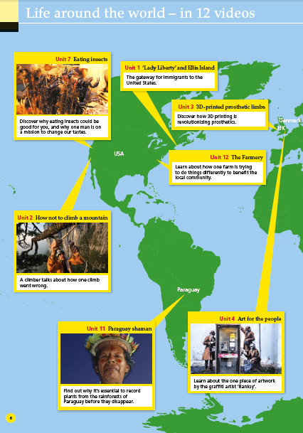
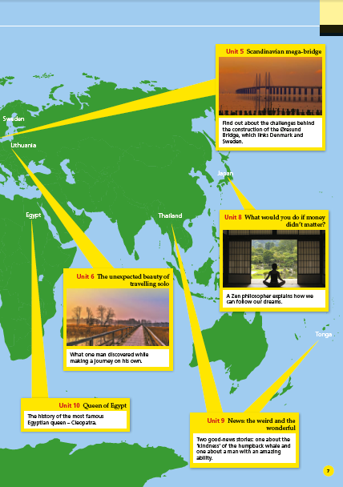
…connect to and personalize fascinating, relevant global topics from National Geographic

Slide 6
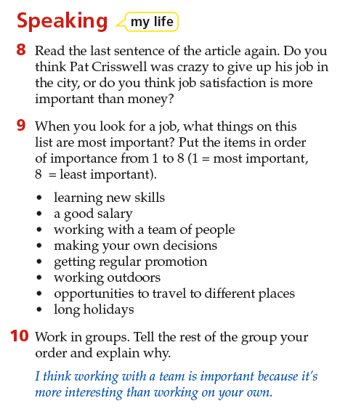
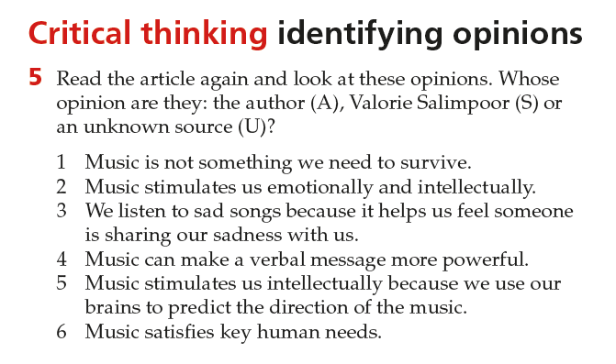
…develop and share well-informed opinions

Slide 7
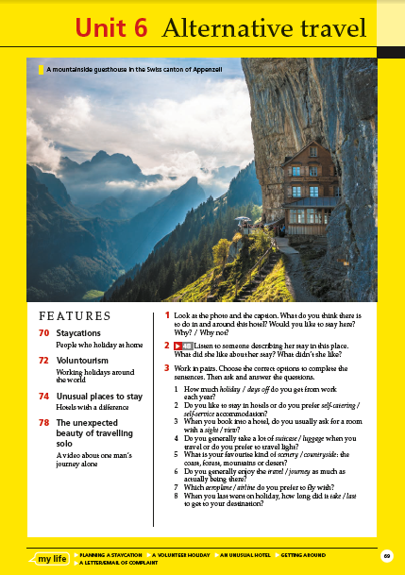
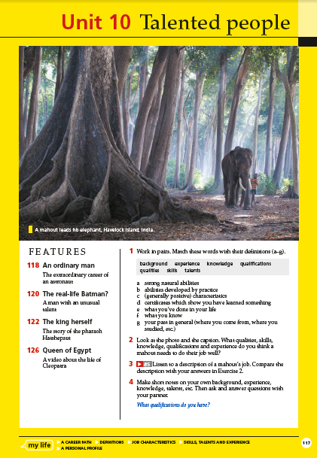
…have a memorable learning experience

Slide 8
Here’s how…
Updated and relevant National Geographic content, photography, and video engages learners by connecting them to people and places from around the world
New ‘My Life’ sections help learners explore the connections between the content and their own lives
An extended critical thinking syllabus encourages learners to develop and share well-informed opinions
Learning is made more memorable through the power of images, real stories and new ‘Memory Booster’ activities that improve students’ ability to retain new language
Exciting new technology makes learning lively and easily accessible

Slide 9
Life helps learners connect to the world.
Notes:
Personalization and connection section.

Slide 10
Notes:
The first edition of Life brought the world to your classroom through stunning National Geographic photography, fascinating readings, and amazing video.
The second edition features updated content that is contemporary and motivating for young adult and adult learners.

Slide 11
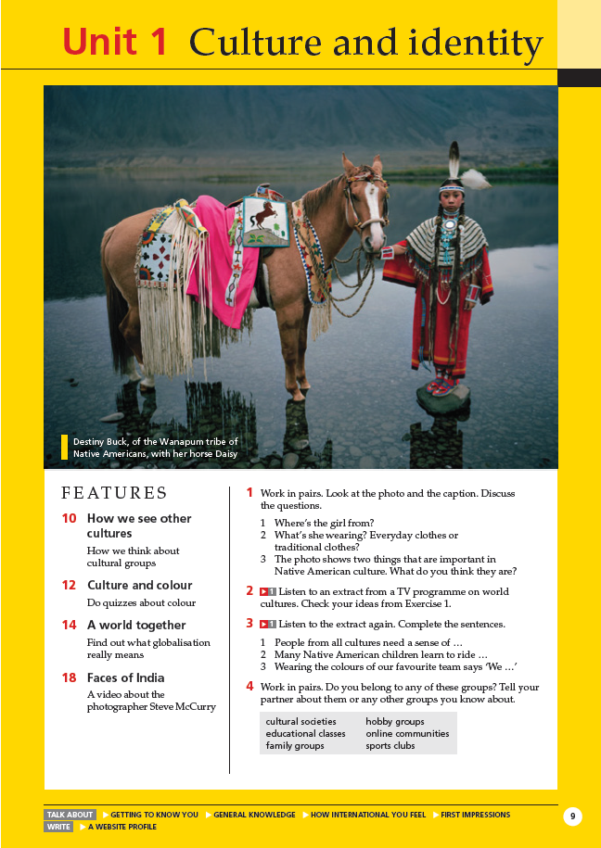
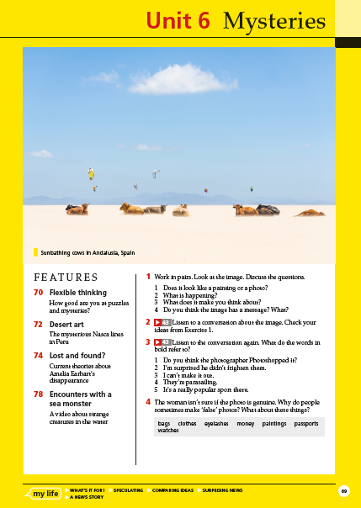
From “Colour” to “Culture and Identity”
From “Weird News” to “Mysteries”
Notes:
And now in the second edition, we do this even more effectively through broadened content that is highly relevant to your learners’ lives. The content is still global, but your learners will more easily and naturally draw connections between those topics and their own lives.
Here are a couple of examples…
The more narrow unit topic of Colour has been broadened to Culture and Identity. It still includes how colour is perceived in different cultures, but this wider topic now allows for learners to relate to the content in many different ways.
And here in Unit 8, the topic of Weird News has been broadened to Mysteries, teaching learners to develop problem-solving skills through exploring popular legends from around the world.

Slide 12
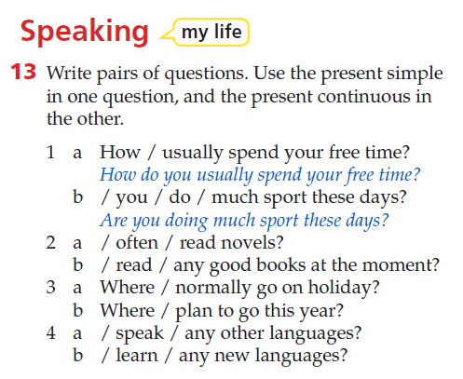
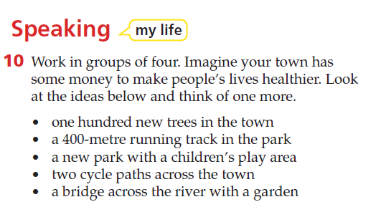
Introducing new ‘My Life’ sections…
Helping learners to connect global topics to their own lives
Notes:
In addition to selecting the right topics for your learners, the second edition offers brand new sections that reinforce learners’ connection between the topics and their own lives.
Giving learners the opportunities to personalize these global topics builds a foundation for more authentic language. Since the answers to the questions are known to the learners, it’s a way to build confident communication around interesting topics in the classroom. Let’s take a look at a couple of examples…

Slide 13
“The topics incite interest in the students and are a great way to prompt discussion, debates, and further investigation from the students.”
Bridget Flynn
Centro Colombo Americano
Medellin, Colombia

Slide 14
Through updated, relevant National Geographic content and new ‘My Life’ sections, Life helps your learners connect to the world.

Slide 15
Life helps learners to think critically so that they can develop and share well-informed opinions

Slide 16
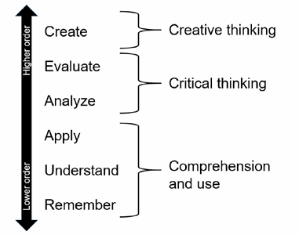
Life teaches learners basic comprehension skills AND how to use what they’ve learned.
Notes:
Having understood the meaning of something, you can begin to analyze and evaluate new information.

Slide 17
Why is critical thinking relevant to English language teaching?
learners develop their ability to question and process information
the lessons are learned more deeply
lessons are more motivating and engaging when they demand different levels of higher order thinking
Notes:
(get ideas from the audience before populating response)
Encouraging critical thinking means that learners develop their ability to question and think independently and to process information;
in doing this they learn more deeply.
In addition, classroom activities and tasks are more motivating and engaging when they demand different levels of higher order thinking (both critical and creative thinking).

Slide 18
Life helps your learners think critically to develop and share their own opinions in English through…

Slide 19
Life teaches learners to think critically through…
Information-rich topics
Carefully-crafted vocabulary and grammar activities
Thought-provoking National Geographic photography
Updated video material
Explicit ‘Critical Thinking’ sections

Slide 20
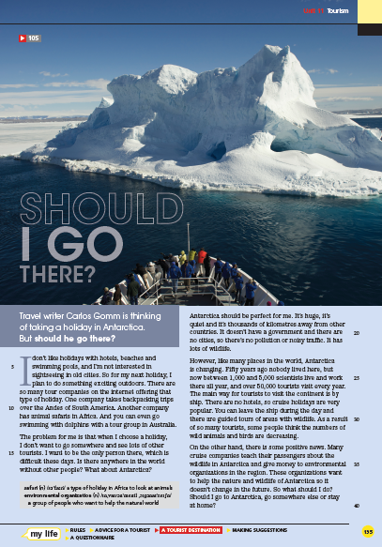
…information-rich topics
Notes:
With Life, learners will leave your classroom having learned NEW things about the world. Learning new information in a second language challenges learners to move beyond comprehension and ask questions like, “I wonder if…, or What happens when…, or What if I was in a similar position….”

Slide 21
…carefully-crafted vocabulary activities
Notes:
Throughout the unit, carefully-crafted vocabulary and grammar activities develop critical thinking skills. For example, take a look at this vocabulary task. The purpose of the activity is to get students using and thinking about the topic and target vocabulary terms. But they are also analyzing and discussing a most-likely unfamiliar expression in a way that is on-target for their language level.

Slide 22
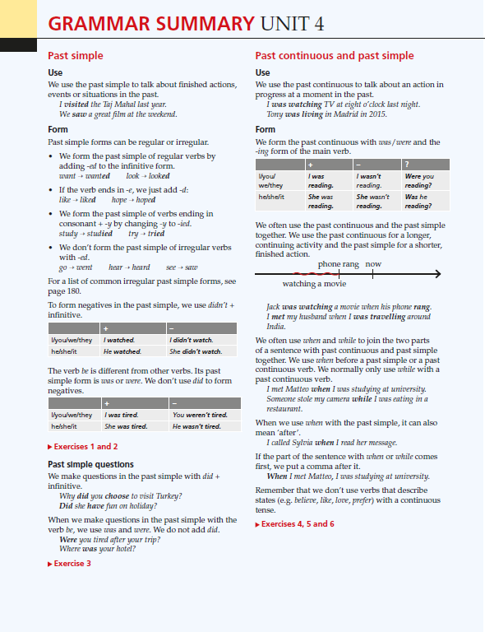
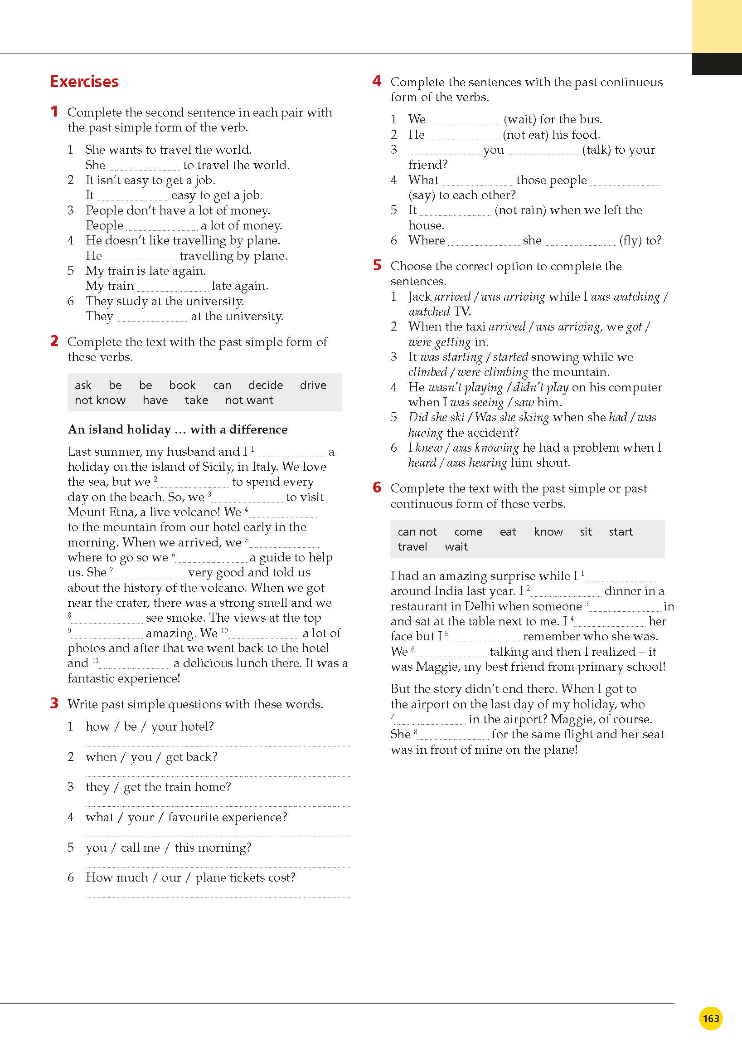
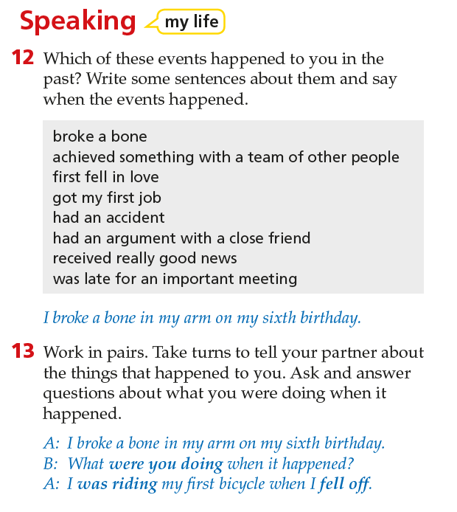
…and carefully-crafted grammar activities
Notes:
And this is an example of a guided discovery grammar task that requires some higher order thinking. (walk through the first two tasks – Answers: 1. fell 2. were going/wasn’t moving/was breathing).
Please note that in the new edition, the grammar presentations is clearer and more comprehensive.
Lets just take a moment to look at the grammar syllabus in Life Second Edition. The grammar analysis and practice is stronger, with extra practice activities and precise grammar analysis.
The following speaking activity is a fluency/communicative activity but also with further practice of the grammar point.
In addition, the newly updated Grammar Reference section in the back of the book offers further grammar presentation and practice for each unit.

Slide 23
….thought-provoking National Geographic photography.
…thought-provoking National Geographic photography.
Notes:
Real photography alone can get students asking questions.
For example, this photograph asks what question? (why is there a table in the middle of the desert? Who’s eating there?)
And this one: (what is she writing? Why? What’s a “bucket list?”)
And finally: What is that woman doing above the street?

Slide 24
…updated video material
Notes:
70% of the highly-acclaimed Life video program has been updated for the new edition to reflect the most interesting, high-quality content from around the world! Many of the new video clips like this one comes from the National Geographic Film Showcase which features new, up and coming filmmakers from around the world that is carefully curated by the experts at National Geographic.

Slide 25
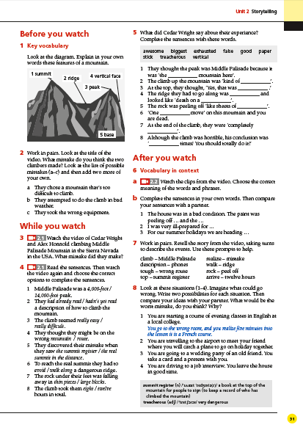
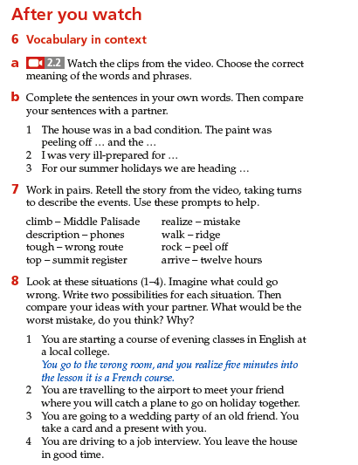
Notes:
Each unit features National Geographic video and note that the new edition emphasizes the “After You Watch” activities.
Here students are asked to personalize the language of the video while applying critical and creative thinking skills.

Slide 26
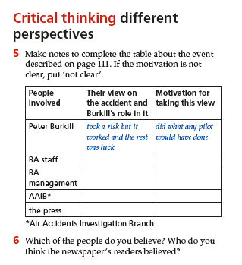
…explicit ‘Critical Thinking’ sections
Notes:
All of these elements are reinforced through explicit ‘Critical Thinking’ sections in Lesson C. With important skills like using language to determine if something is a speculation or a fact and understanding different perspectives in a reading. And, these sections teach learners to think critically in relation to reading skills development.

Slide 27
Life teaches learners to think critically through…
Information-rich topics
Carefully-crafted vocabulary and grammar activities
Thought-provoking National Geographic photography
Updated video material
Explicit ‘Critical Thinking’ sections

Slide 28
Life makes learning memorable

Slide 29
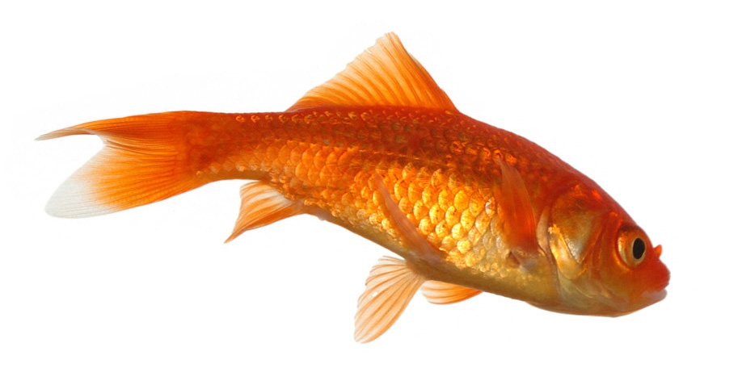
9 seconds
8 seconds
Notes:
The average attention span for the notoriously ill-focused goldfish is nine seconds, but according to a study from Microsoft, people now generally lose concentration after…(ask audience to guess)….eight seconds.
Further, about 70% of what we forget is forgotten in the first 24 hours after learning. That may help to explain why our students, who seem so good at using a particular grammatical structure by the end of one lesson, are struggling to use it correctly the following week.

Slide 30
Life helps overcome this challenge by making learning memorable
Notes:
Here’s how…

Slide 31
The power of images: seeing the usual in unusual ways
Notes:
Co-author Paul Dummett talks about this in our NGL In Focus blog…
Our minds and memories work in images. 50% of our brain’s activity is devoted to vision and visualization. As language teachers we can exploit this by using images - especially powerful images - to support discourse or by presenting language in such a way that students can more easily visualize it.
So when students read or hear a description, ask them to describe the images that come to mind.
(A bookstore in China)

Slide 32
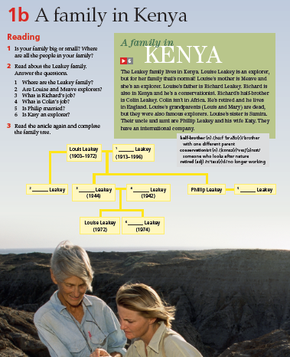
The power of real stories
Notes:
Paul Dummett goes on to discuss that we recall events more easily than facts. That is because stories provide a familiar framework for us to place events in. This makes stories an ideal vehicle for consolidation of language learning.
And Life is full of real stories of fascinating people doing amazing things which helps build a solid and memorable foundation for language learning. And not only explorers, but real people living their lives around the world.

Slide 33
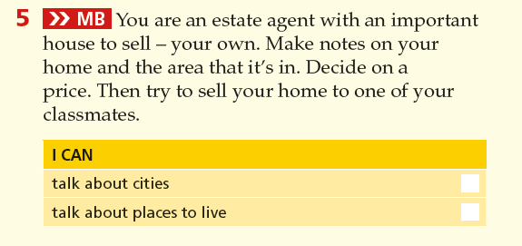
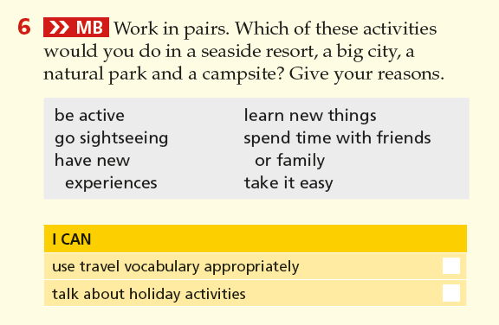
New ‘Memory Booster’ activities
Notes:
New ‘Memory Booster’ activities in every review section improve students’ ability to retain and use new language. Let’s take a look at one…

Slide 34
Life makes learning memorable through…
The power of images
The power of real stories
New ‘Memory Booster’ activities

Slide 35
New technology makes learning lively and easily accessible

Slide 36
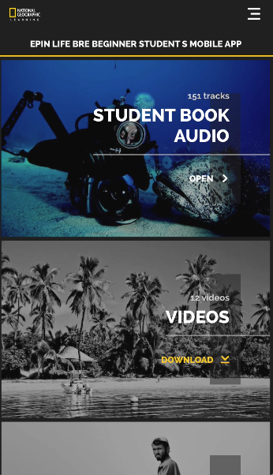
The new Life Student App with each Student’s Book contains:
Video
Audio for the Student’s Book
Audio for the Workbook
Grammar Practice
Interactive reading practice
Expanded wordlists
Games

Slide 37
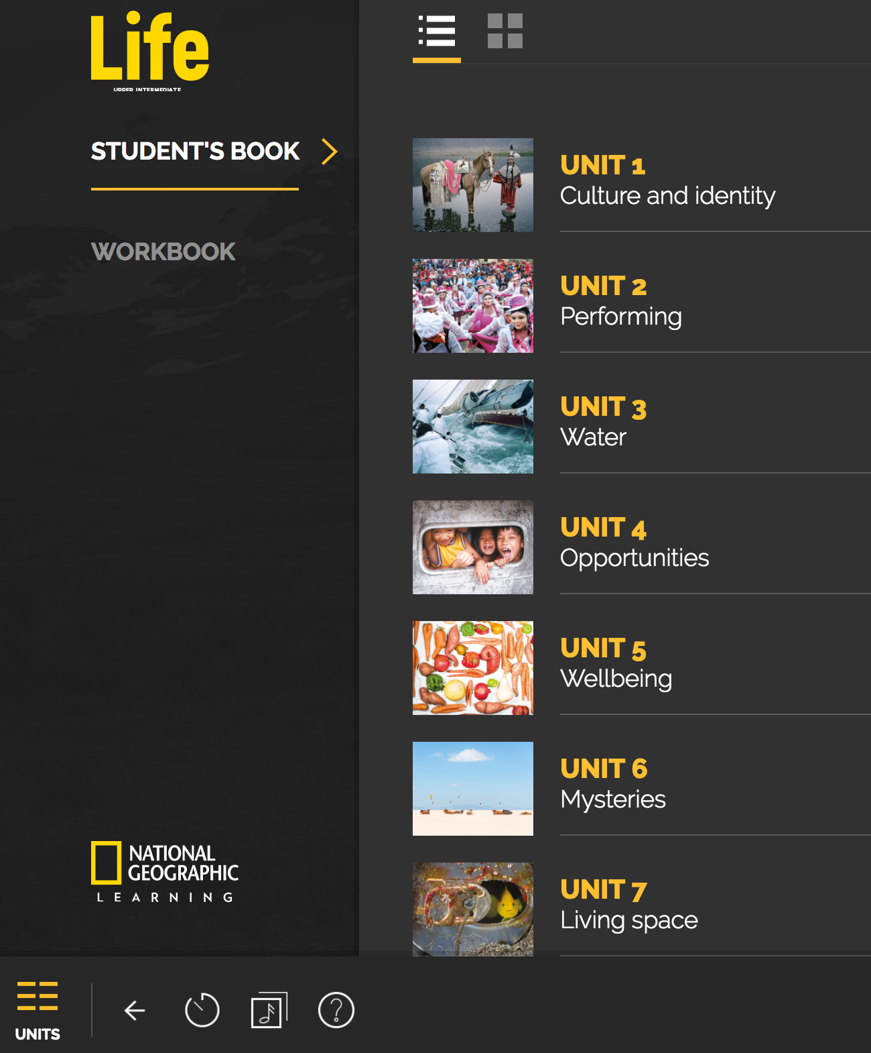
The Enhanced Life Classroom Presentation Tool
Notes:
The enhanced Classroom Presentation Tool makes instruction easier and increases classroom communication!
-All audio and video resources available at point-of-use
-All activities are interactive to maximize group participation and you can now zoom in on all parts of the page.
-Navigation is simple and now includes access to the workbook pages!

Slide 38
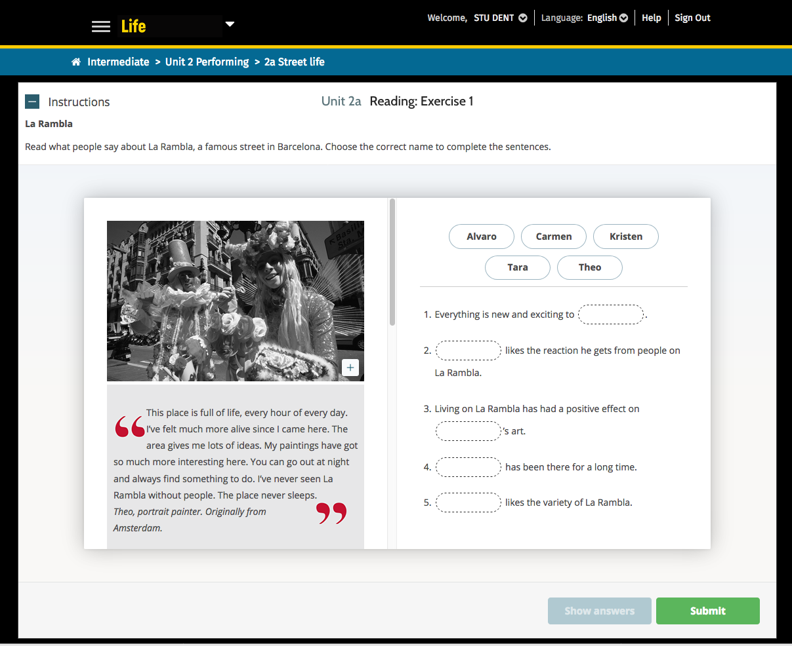
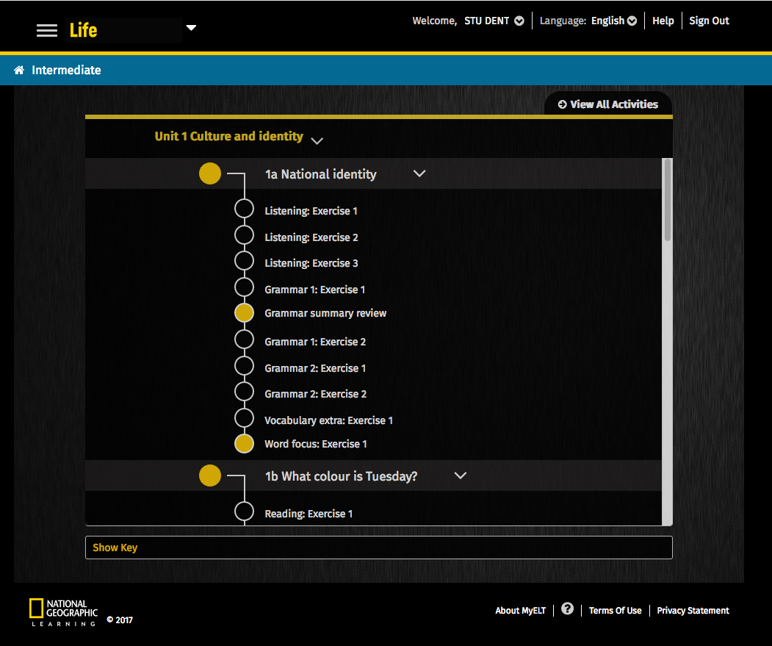
The Life Online Workbook
Easy-to-navigate learning path
Reinforcement activities for all skills tied to the lessons in the Student Book, including all of the videos
Grammar tutorials and flashcards automatically populate for learners when needed
Re-teaching in grammar and vocabulary when needed
Notes:
Based on individual performance, learners who require additional support will automatically receive re-teaching in grammar and vocabulary when needed.
“When needed” is if they score below 70%. They receive automated grammar tutorials for grammar and flashcards for vocabulary. It’s important to stress that these aren’t activities or exercises but additional instructional elements.

Slide 39
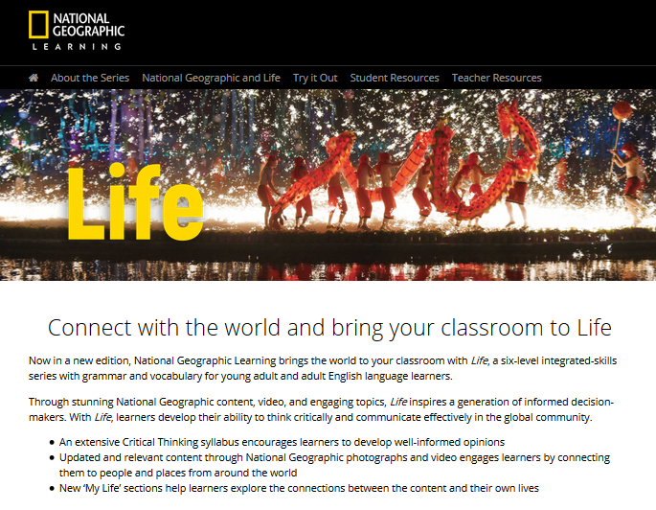
The Life Resource Site
Student Resources
Student’s Book Video
Student’s Book Audio
Workbook Audio
Teacher Resources
Sample units
Ready-made lessons
Audioscripts and videoscripts
Reading Texts
CEFR Correlations
Word Lists
Grammar Practice Worksheets
Pacing Guide
Extra Practice Activities
Business Writing Support
Communicative Worksheets
Placement Test
NGL.Cengage.com/life

Slide 40
Life, Second Edition features...
Updated and relevant National Geographic content, photography, and video engages learners by connecting them to people and places from around the world
New ‘My Life’ sections help learners explore the connections between the content and their own lives
An extended critical thinking syllabus encourages learners to develop and share well-informed opinions
Learning is made more memorable through the power of images, real stories and new ‘Memory Booster’ activities that improve students’ ability to retain new language
Exciting new technology makes learning lively and easily accessible

Slide 41
And also...
Updated video material featuring interesting, contemporary, and high-quality National Geographic video
A refined grammar syllabus provides increased scaffolding and an enhanced reference section
Revised vocabulary in the reading sections focuses on high-frequency terms needed to understand the meaning
An improved Classroom Presentation Tool now includes the Workbook pages, extra support, and extension activities
A new Student App with each Student’s Book includes video, audio for the Student’s Book and Workbook, grammar practice, interactive reading practice, expanded wordlists, and games

Slide 42
With Life in your classroom, your learners will…
Connect to and personalize fascinating, relevant global topics from National Geographic
Develop and share well-informed opinions
Have a memorable learning experience

