Slide 1
myTime ENGLISH
Bringing the world to the classroom and the classroom to life.
NGL.Cengage.com/mytimeenglish
A PART OF CENGAGE

Slide 2
myTime ENGLISH
myTimeENGLISH is an easy-to-use, fully online, self-access General English program.
myTimeENGLISH empowers learners to achieve their personal language goals at their own pace.
Notes:
MyTimeENGLISH is an easy-to-use, online General English program that empowers learners to achieve their personal language goals on their own, at their own pace.

Slide 3
Motivating Structure for Self-directed Learners
Clear learning path
Meaningful objectives
Opportunities for choice and re-learning
Beautiful National Geographic images
180 integrated videos
Over 200 animated grammar presentations
Over 2800 interactive activities
Notes:
Perfect for blended courses that offer some limited face-to-face instruction.
These features motivate the learner to move through their independent work so that they come to class prepared to communicate and participate.

Slide 4
myTimeENGLISH Program Structure
Placement Test
All students complete a Placement Test (51 questions), placing them at the appropriate level of MyTimeEnglish.
4 Levels
General English, integrated skills
Notes:
Placement Test
All students complete a Placement Test (50 questions) which will place at them appropriate Level in the MyTimeEnglish course.
5 Levels
The program is made up of 5 Levels
Levels 1-4 (General English) are instructional
Level 5 includes Test prep and Reading

Slide 5
Correlations and Coursework Hours
MyTimeEnglish | CEFR | Proficiency Level | Estimated Hours of Coursework
Level 1 | A1 to A2 | Beginning to High Beginning | 60-90
Level 2 | A2 to B1 | High Beginning to Low Intermediate | 60-90
Level 3 | B1 to B1+ | Low Intermediate to Intermediate | 60-90
Level 4 | B1 to B2 | Intermediate to High Intermediate | 60-90
Notes:
As this is a self-paced tool, the number of hours is an estimated and will vary from student to student.

Slide 6
myTimeENGLISH Program Structure
Progress Tests
Each level is divided into 3 Parts (5 Units Each)
A Progress Test is administered at the end of Parts 1 and 2.
Completion of the test unlocks and provides access to the next Part.
Final Tests
Each level ends with a Final Test
A score of 60% or greater unlocks the next Level and locks the previous Level.
Notes:
Progress Tests
Levels 1, 2, 3 and 4 are broken down in 3 Parts
A Progress Test is administered at the end of Parts 1 and 2.
Favorable completion of the test unlocks and provides access to the next Part/Section
Final Tests
Levels 1, 2, 3 and 4, all have a Final Test at the end of each Level (after Part 3).
A score of 60% or greater unlocks the next Level and closes/locks the previous Level.

Slide 7
Placement Test
myTimeENGLISH
Notes:
Every student in MyTimeENGLISH begins with a Placement Test

Slide 8
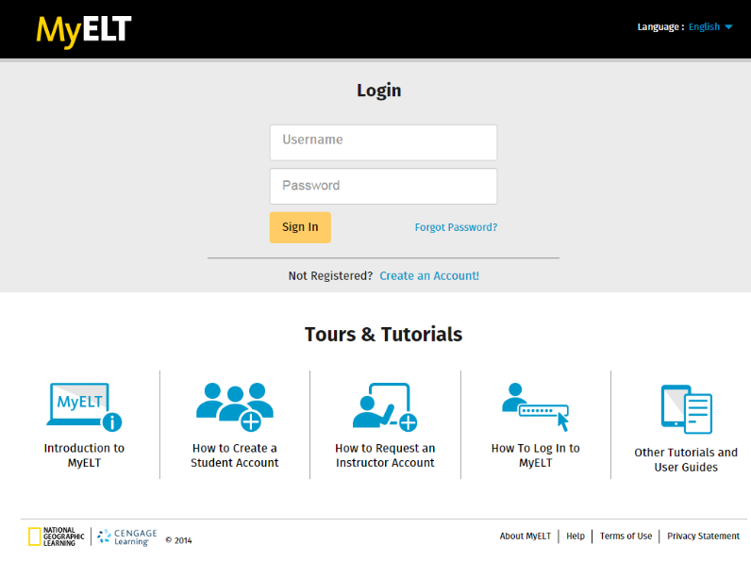
To begin myTimeENGLISH, go to myelt.heinle.com…
Login with username and password
Notes:
To begin MyTimeENLISH , go to myelt.heinle.com…
Login with username and password

Slide 9
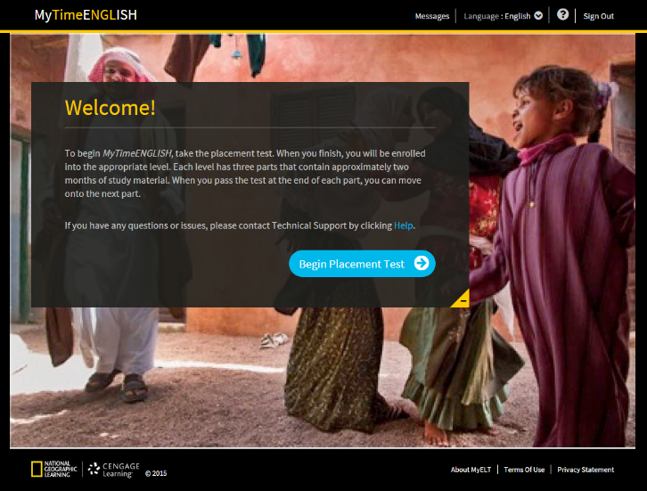
Click on Begin Placement Test
Notes:
Let’s take a look at the students experience…
Every student begins by taking a Placement Test

Slide 10
Placement Test To advance through the Placement Test, students click on the gray arrow in the lower right-hand corner. Also, note the blue progress bar at the bottom of the activity screen.
Notes:
To advance through the Placement Test, students click on the gray arrow in the lower right-hand corner. Also, note the blue progress bar at the bottom of the activity screen. This progress bar shows the student how they progress at all times on a given question relative to the total number of questions.

Slide 11
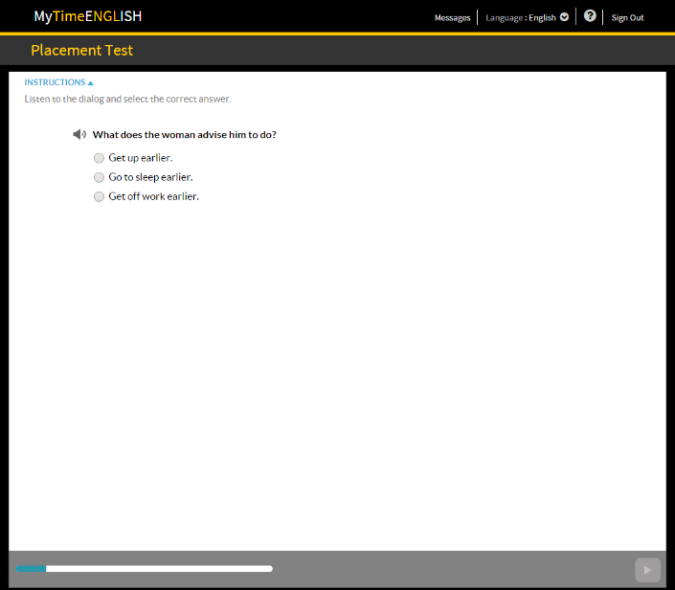
Placement Test The instructions for each activity appear in the upper left-hand corner of the screen. Here are two examples: 1. Listening to the dialog and selecting the correct answer. 2. Selecting the correct response.
Notes:
The instructions for each activity appear in the upper left-hand corner of the screen. Here are two examples: 1. Listening to the dialog and selecting the correct answer. 2. Selecting the correct response

Slide 12
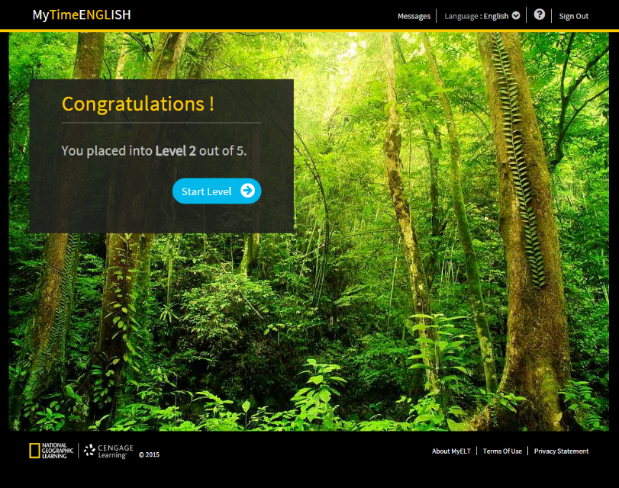
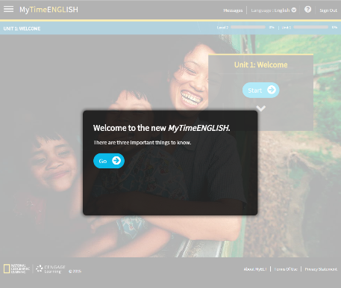
Level Placement Upon completing the Placement Test, students are placed into the appropriate Level of content.
Notes:
Level Placement Upon completing the Placement Test, students are placed into the appropriate Level of content. In this example, the student placed in Level 2 of 5.

Slide 13
Navigating the Course
myTimeENGLISH
Notes:
Once a student has been placed at a specific level within MyTimeENGLISH – they can begin to go through the easy-to-use program…

Slide 14
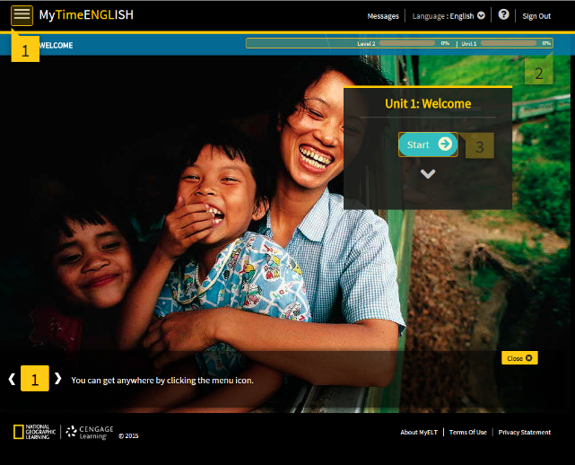
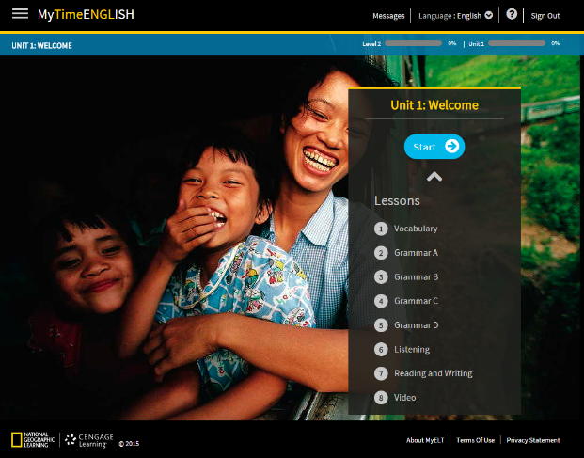
Upon completing the Placement Test, students can begin their English course.
Notes:
Once you have completed your Placement Test, you will immediately be able to start your English course. Just follow the on-screen prompts to navigate through the course.

Slide 15
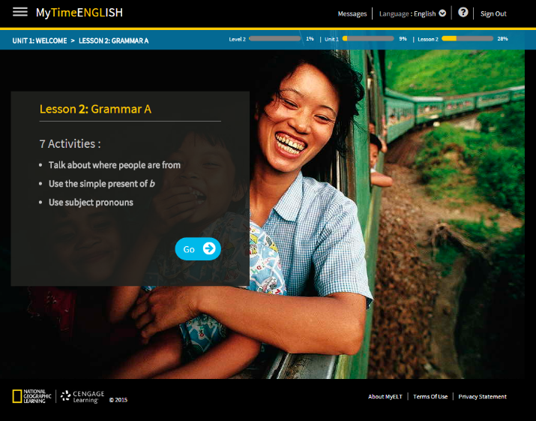
Progress Bars help students track course completion.
Notes:
Progress bars help students track course completion giving them a sense of personal achievement. The progress bars at the top of the screen will students know what Level, Unit and Lesson they are in. The yellow bar also shows their progress in each and the percentage of completion.

Slide 16
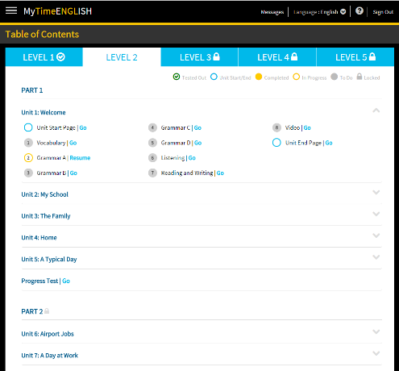
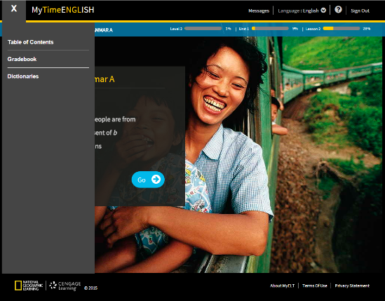
Drop Down Menu
Notes:
You can see the Table of Contents, the Gradebook or the Dictionaries at any time by clicking on the drop-down menu in the upper left-hand corner of the screen

Slide 17
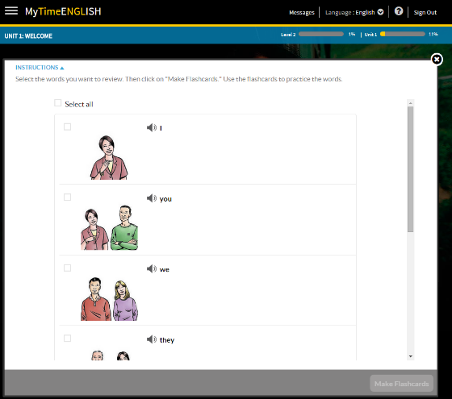
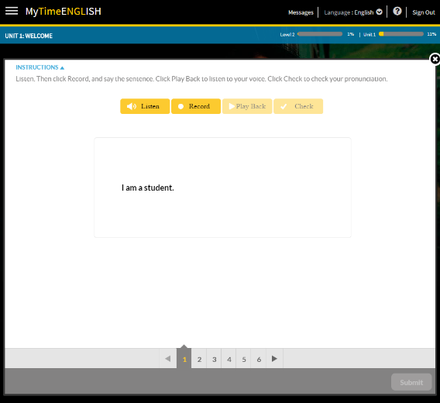
Review Activities
Notes:
The Review activities give students more practice in an area specific to the Unit you are finishing.

Slide 18
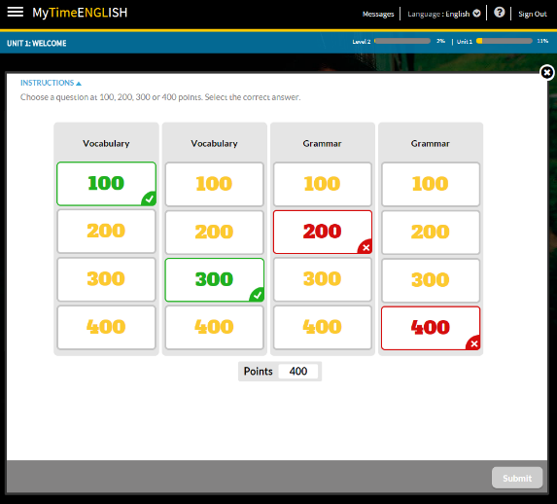
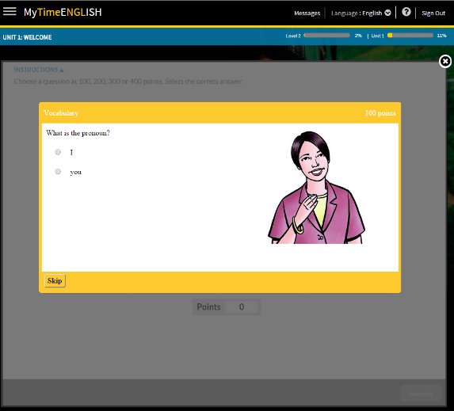
Unit Test (game-based test) assesses student’s knowledge
Notes:
The Unit Test at the end of each Unit is a game-based test for you to see how much you have learned. You will see your correct and incorrect answers on the screen and your final score will be posted to your gradebook. Be sure to click on Submit in the lower right-hand corner to submit you answers.

Slide 19
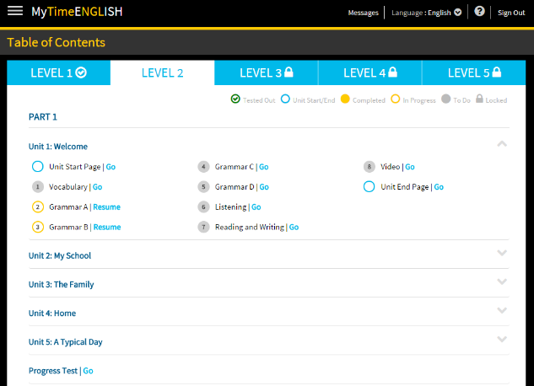
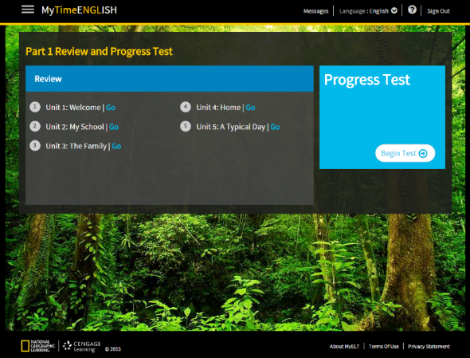
Progress Tests All levels feature 2 Progress Tests (Parts 1 and 2).
Notes:
Levels 1, 2 3 and 4 each have 2 Progress Tests. You must complete the Progress Test to start the next Part, but you are not required to achieve a certain score.

Slide 20
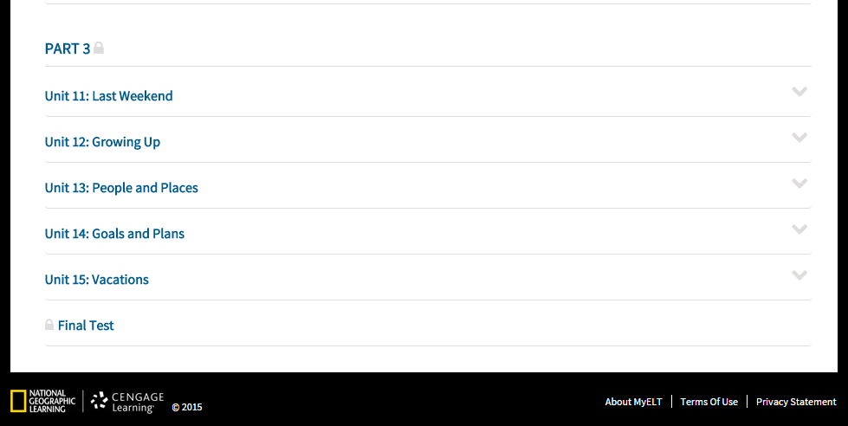
Final Tests All levels end with contain a Final Test.
Notes:
Levels 1, 2 3 and 4 all contain a Final Test in Part 3. This test is similar to the Progress Tests but in order to advance to the next Level, you must score 60% or greater.

Slide 21
Administrator Tools/Reports
myTimeENGLISH

Slide 22
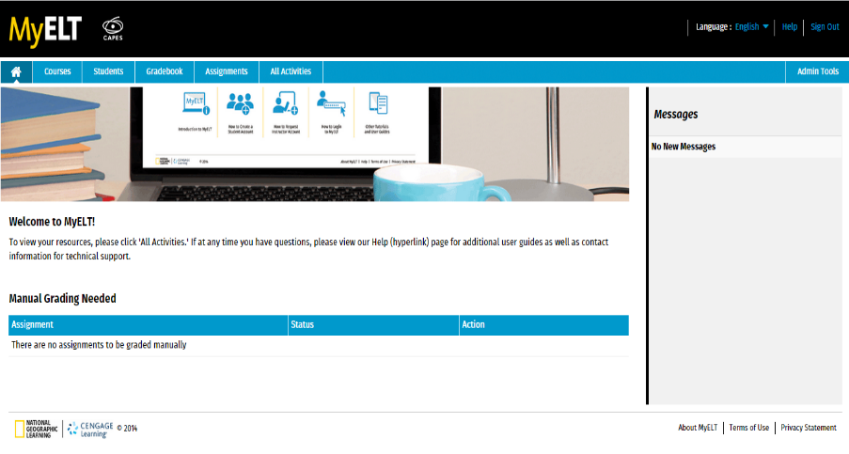
Administrator or Coordinator View

Slide 23
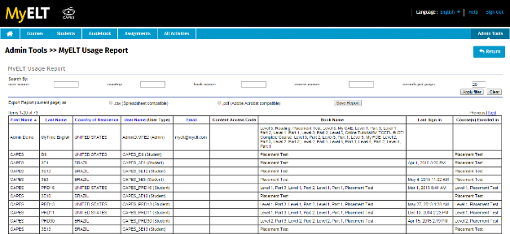
Modified Administrator View/Report
Notes:
Modified Administrator View/Report

Slide 24
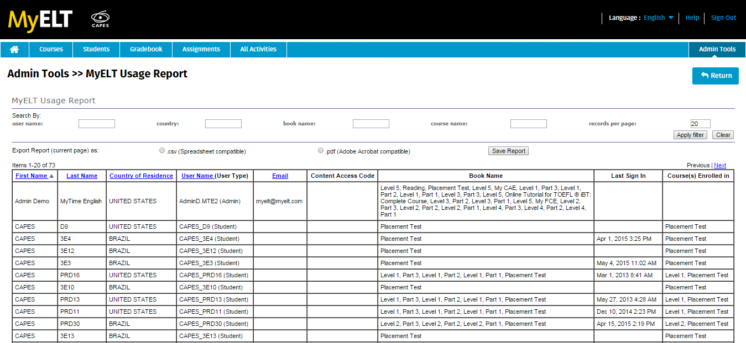
Usage Report
Notes:
Usage Report

Slide 25
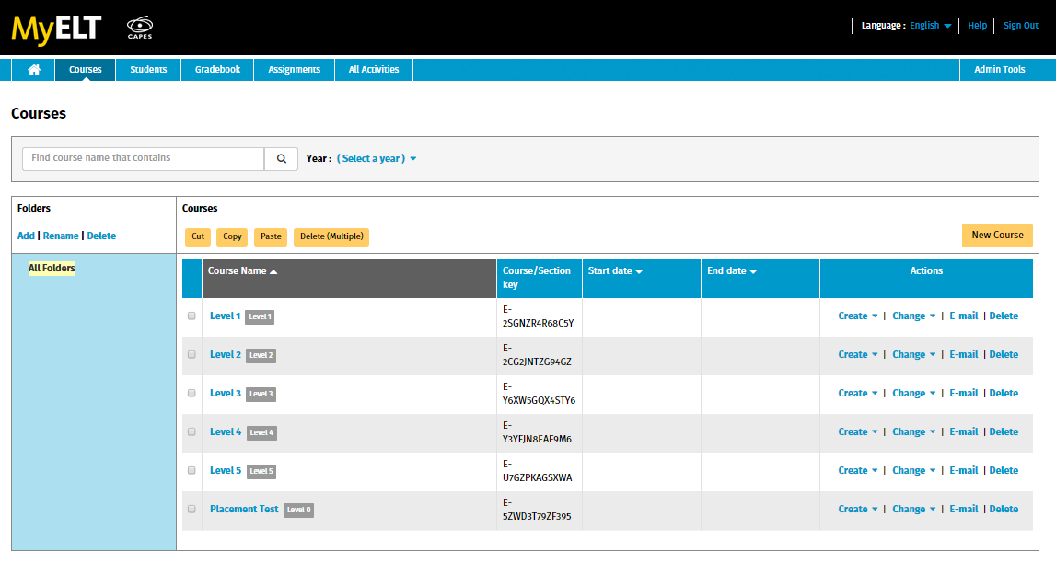
Coordinator View
Notes:
Coordinator View

Slide 26
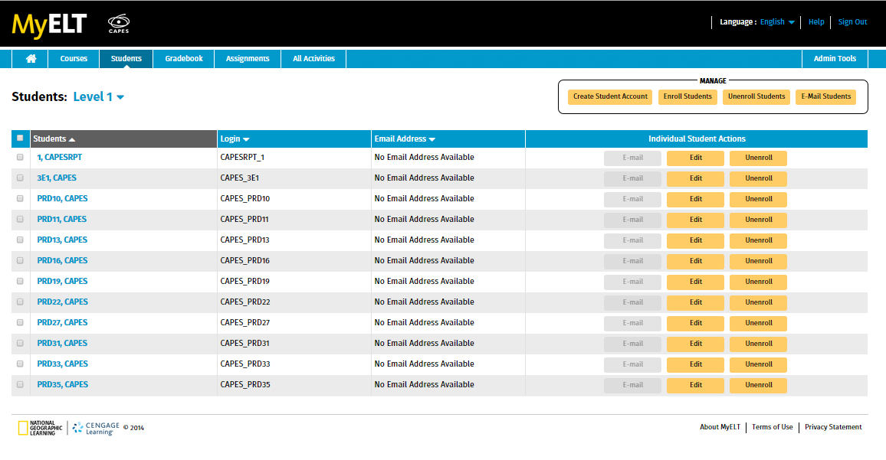
Standard Student View
Confidential
Notes:
Standard Student View

Slide 27
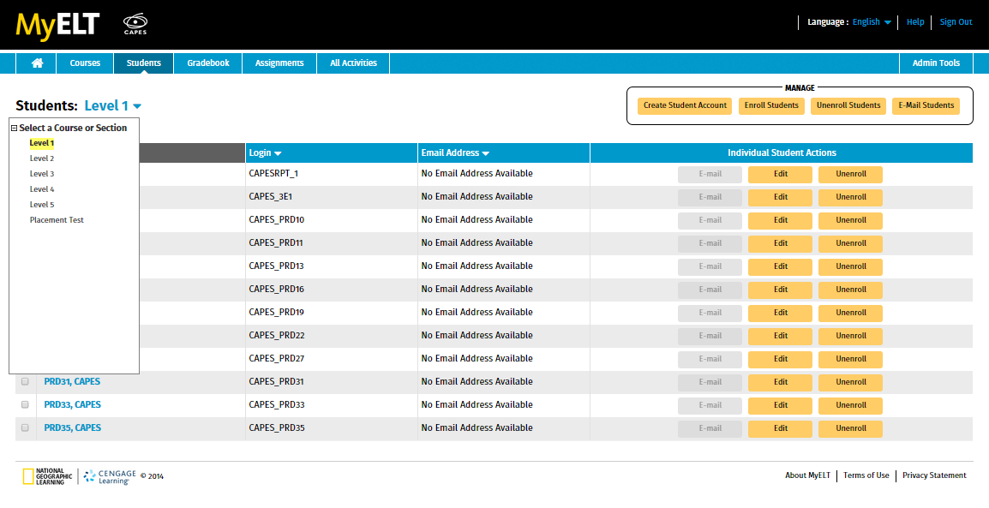
Student View
Notes:
Student View

Slide 28
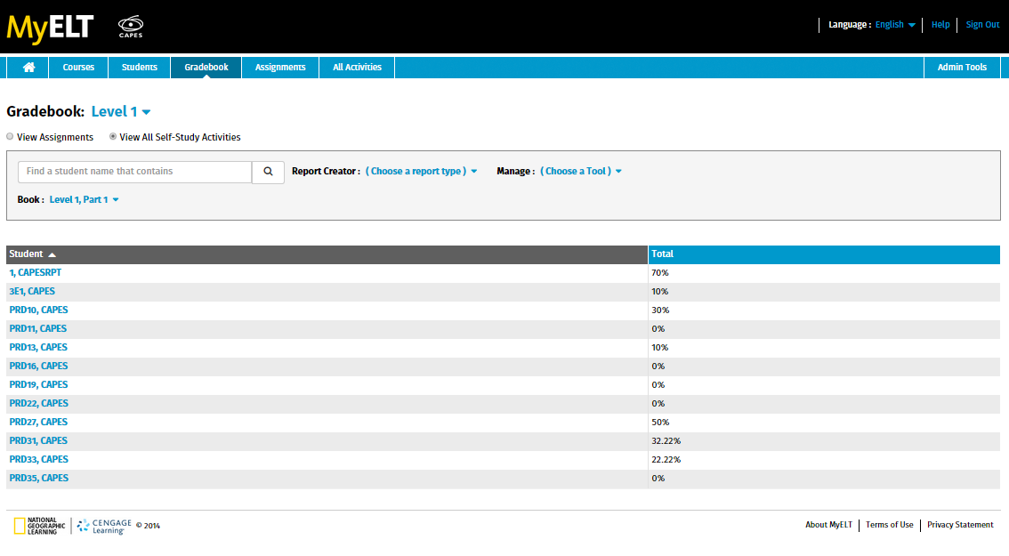
Gradebook View
Notes:
Gradebook View

Slide 29
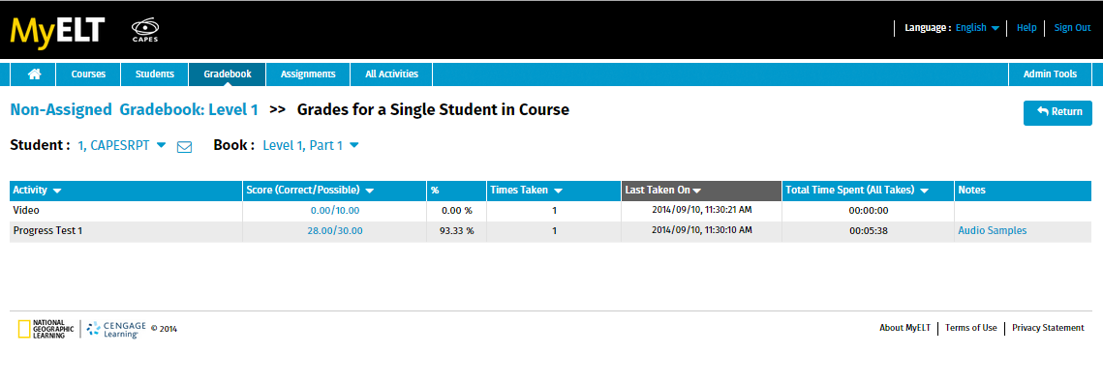
Score Detail View and Audio Sample Review
Notes:
Score Detail View and Audio Sample Review

Slide 30
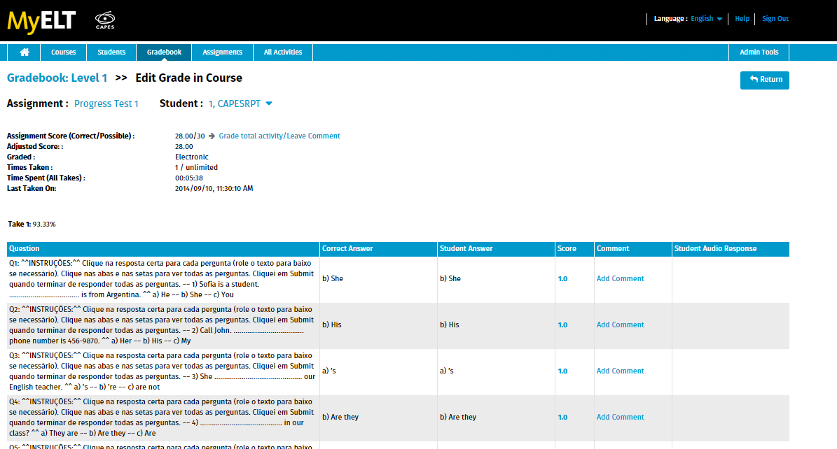
Individual Student Detailed Activity Report
Notes:
Individual Student Detailed Activity Report

Slide 31
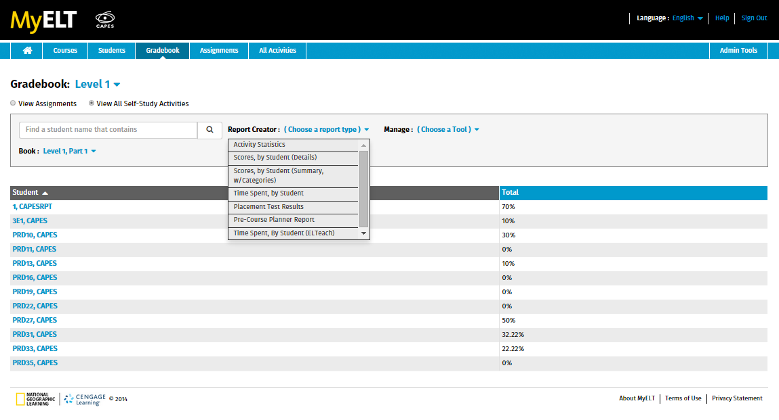
Activity Statistics
Scores, by Student (Details)
Scores by Student (Summary)
Time Spent
Standard MyELT Reports
Notes:
Standard MyELT Reports

Slide 32
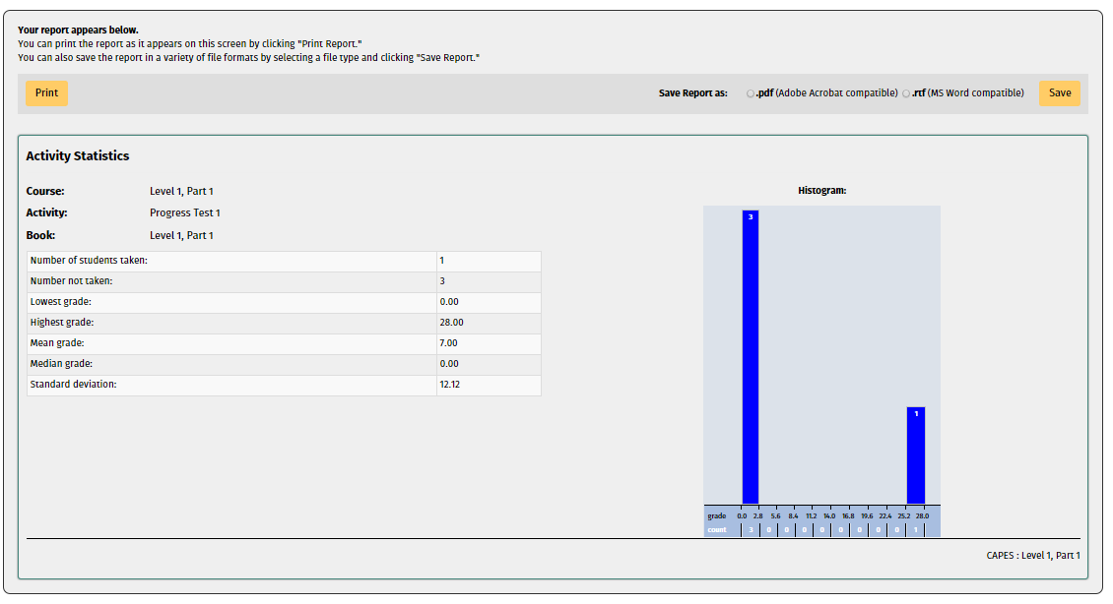
Activity Statistics
Notes:
Activity Statistics: This report shows the number of students who have taken a particular activity in a course and the range of grades and median, mean scores.

Slide 33
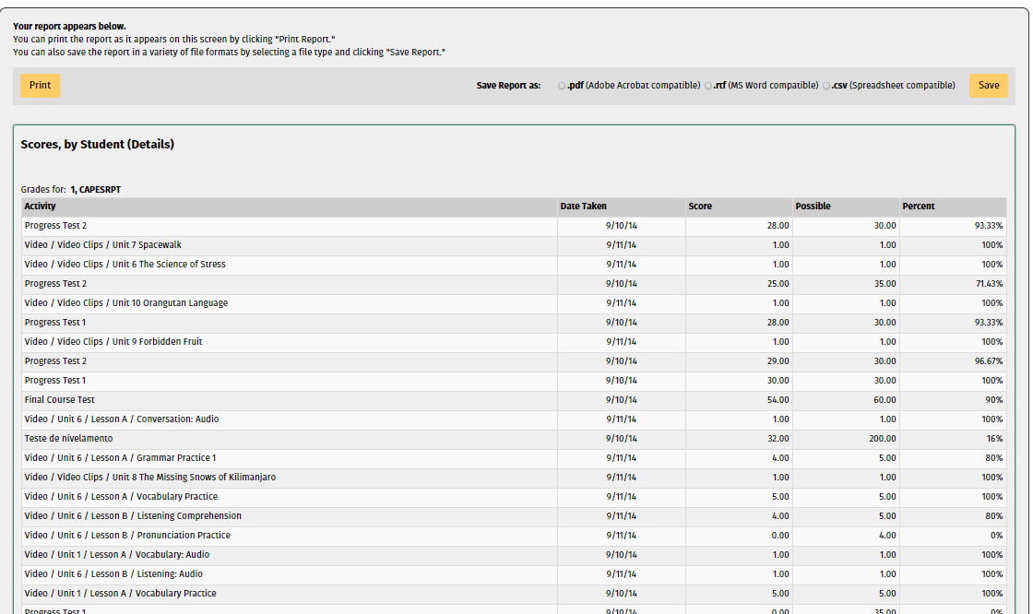
Scores, by Student (Details): Scores for all activities taken by user
Notes:
Scores, by Student (Details): Scores for all activities taken by user
Activity: name of activity the user has taken
Date Taken: date of the user’s last take of that activity
Score: Points the user received
Possible: Total points possible in an activity
Percent: Shows total percentage of the activity the user got correct

Slide 34
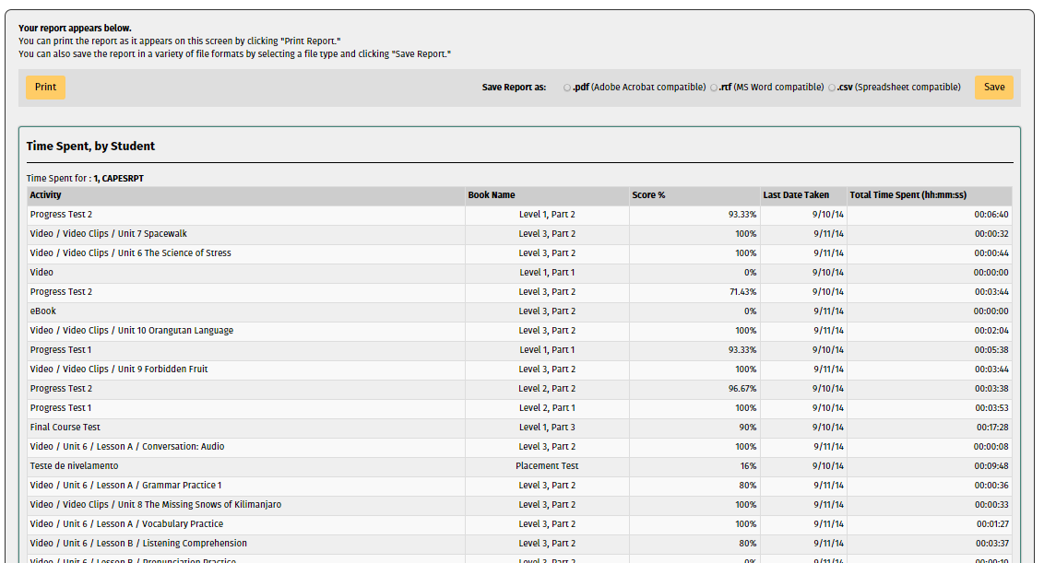
Time Spent, by Student
Notes:
Time Spent, by Student
This report lists all of the activities taken by a student in a course, the book from which the assignments were created, the date that work on the activity was last taken, the score and the total time spent by the student on the activity in question.
Activity: Name of the activity the score refers to
Book Name: Book the activity is from
Score %: Score the student achieved for that particular activity
Last Date Taken: Last time the student attempted the activity
Total Time Spent: Total time the student spent taking the activity – all takes

Slide 35
Implementation Information
myTimeENGLISH

Slide 36
myTimeENGLISH
MyTime English with Placement Test = 9780357452059
MyTime English without Placement Test= 9780357452066
Extended access – available if necessary
Please speak with your local National Geographic Learning representative for more information.

Slide 37
myTime ENGLISH
Bringing the world to the classroom and the classroom to life.
NGL.Cengage.com/mytimeenglish
A PART OF CENGAGE

