Slide 4
Notes:
Reading and writing preparation is found in the:
Grammar Structure lessons
Prewriting practice in the Level 1-2 Letters, Numbers, and Sounds lessons
Phonics lessons in Level 3

Slide 6
Notes:
Joel Sartore is a National Geographic photographer and founder of the Photo Ark. This project raises awareness of endangered animals in zoos and wildlife parks. Joel wants people to care about, fall in love with, and take action to help save these animals.
Photo Ark content is used in:
Letters and Sounds lessons in levels 1-2
Alphabet presentation and poster in all levels
A portion of the sales of Look and See go to support the Photo Ark.

Slide 7
Notes:
What’s in the Student’s Books?
1-page Unit 0
10 main units
6 pages per unit
Lesson 1: Unit Opener
Lesson 2: New Words
Lesson 3 Structure (Grammar)
Lesson 4: Song and Value
Lesson 5:
Level 1: Letters and Sounds/Numbers
Level 2: Letters and Sounds
Level 3: Phonics
Lessons 6 and 7: Video and Project
5 pages of Song lyrics
2 pages of alphabet presentation using Photo Ark photos

Slide 8
Notes:
The Unit Opener Lesson also includes an introductory video clip to present the first target word (HAT in the above).

Slide 9
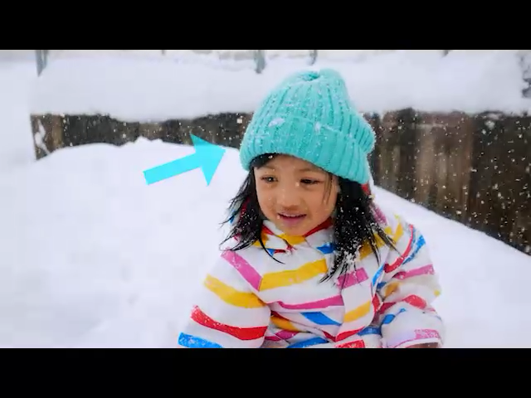
Notes:
Unit Opener Video Scene
Target Word Intro

Slide 11
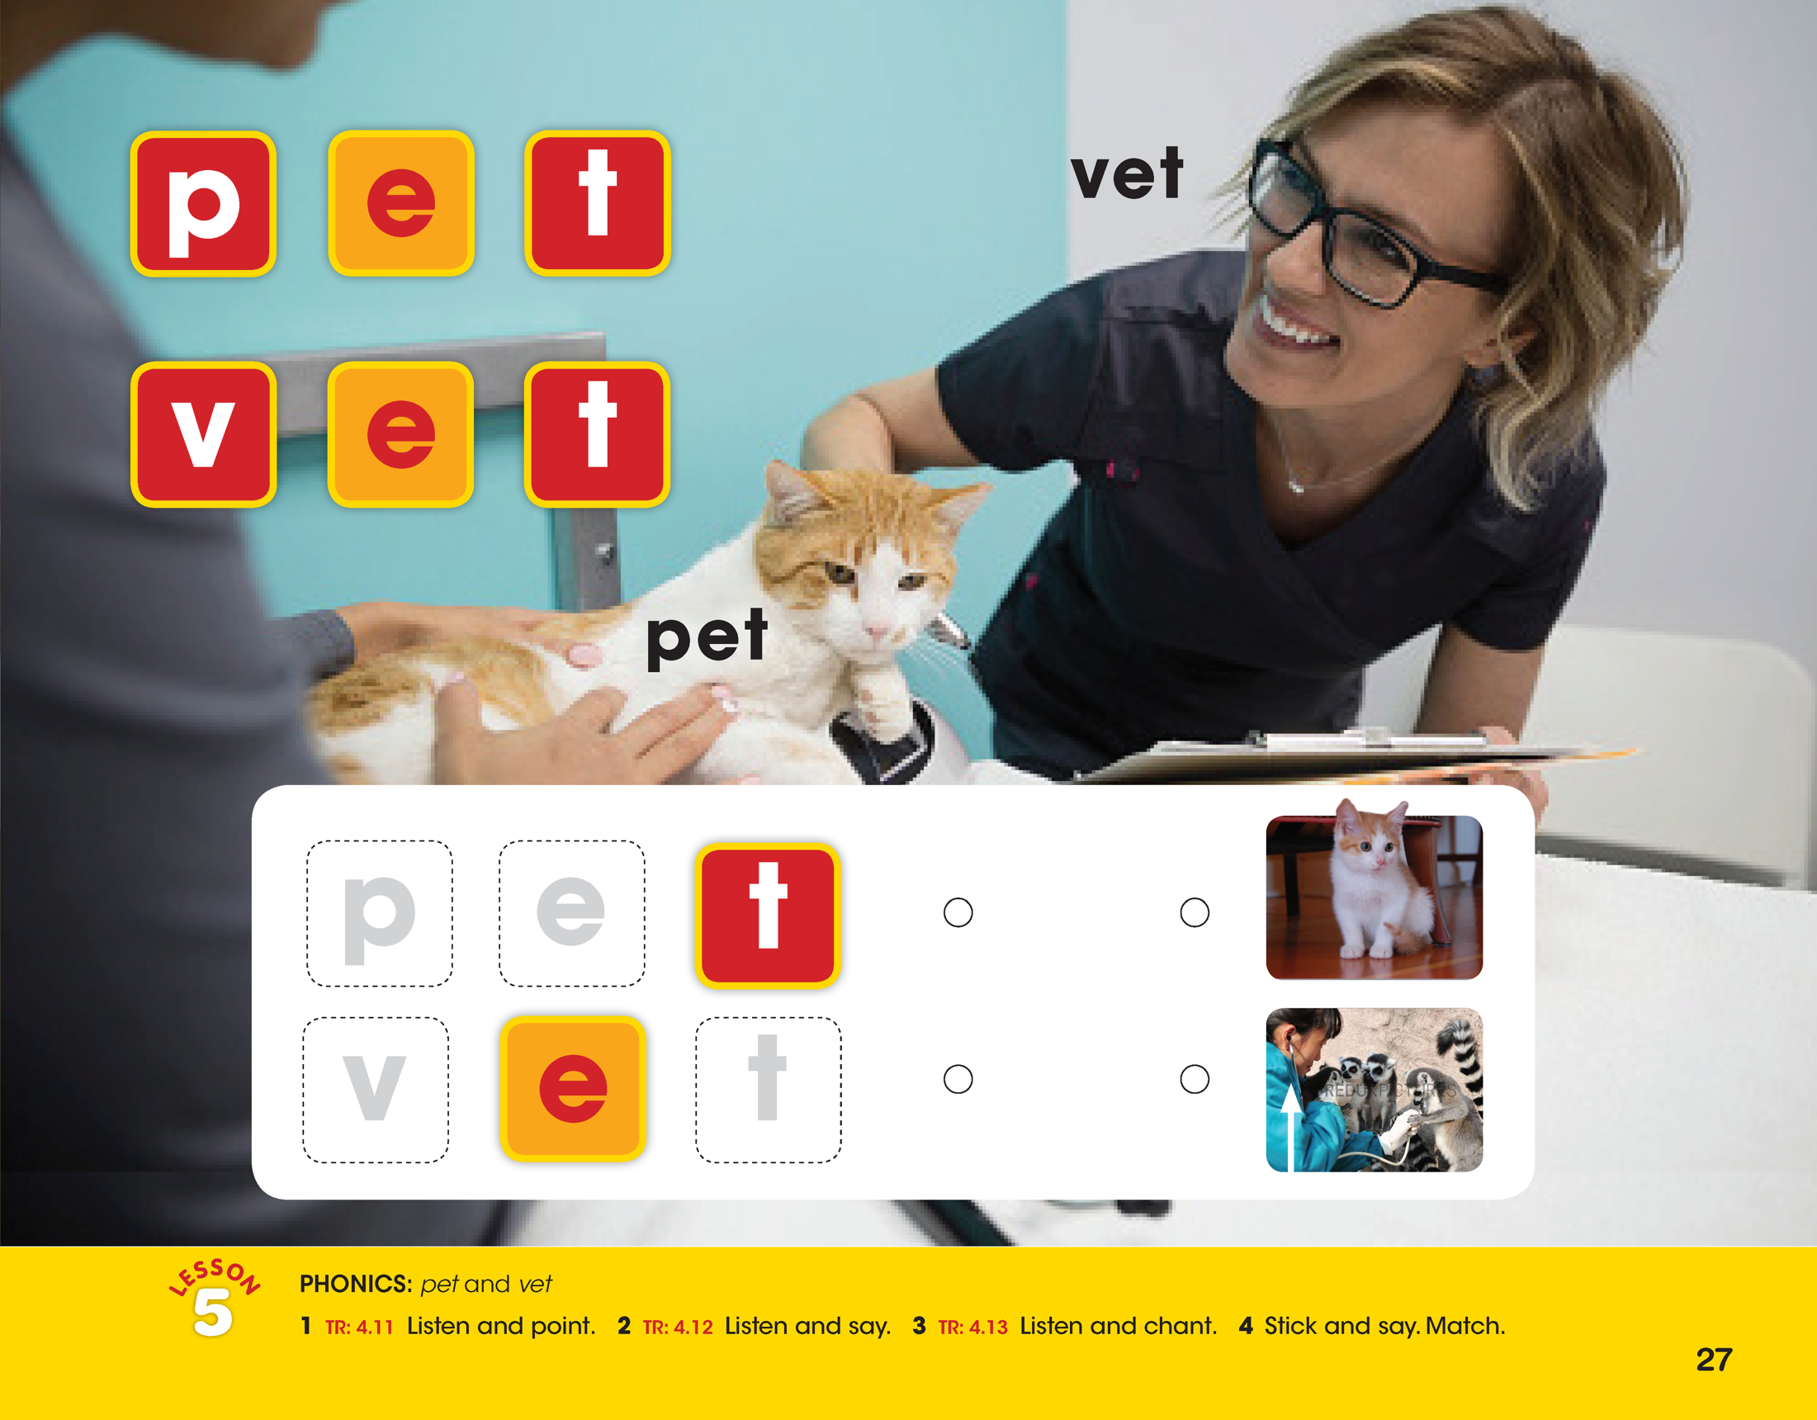

Slide 12
Notes:
The last page of every unit includes both Lesson 6, Video, and Lesson 7, Project.
The direction lines on the page correspond to the Video lesson.
The Lesson 7 Project instructions are in the Teacher’s Book.

Slide 13
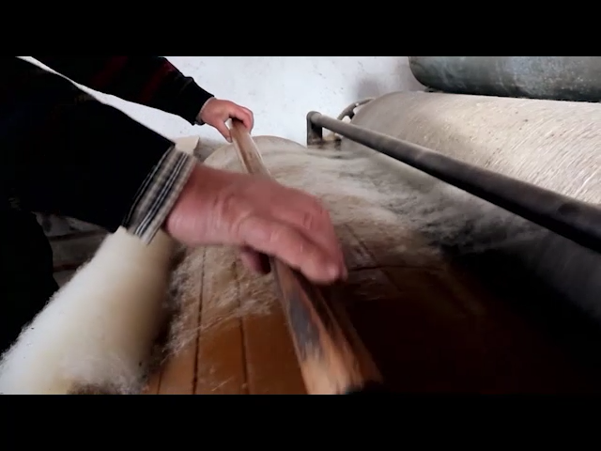
Notes:
Leeson 6 Video lesson video, language practice and real-world exposure

Slide 14
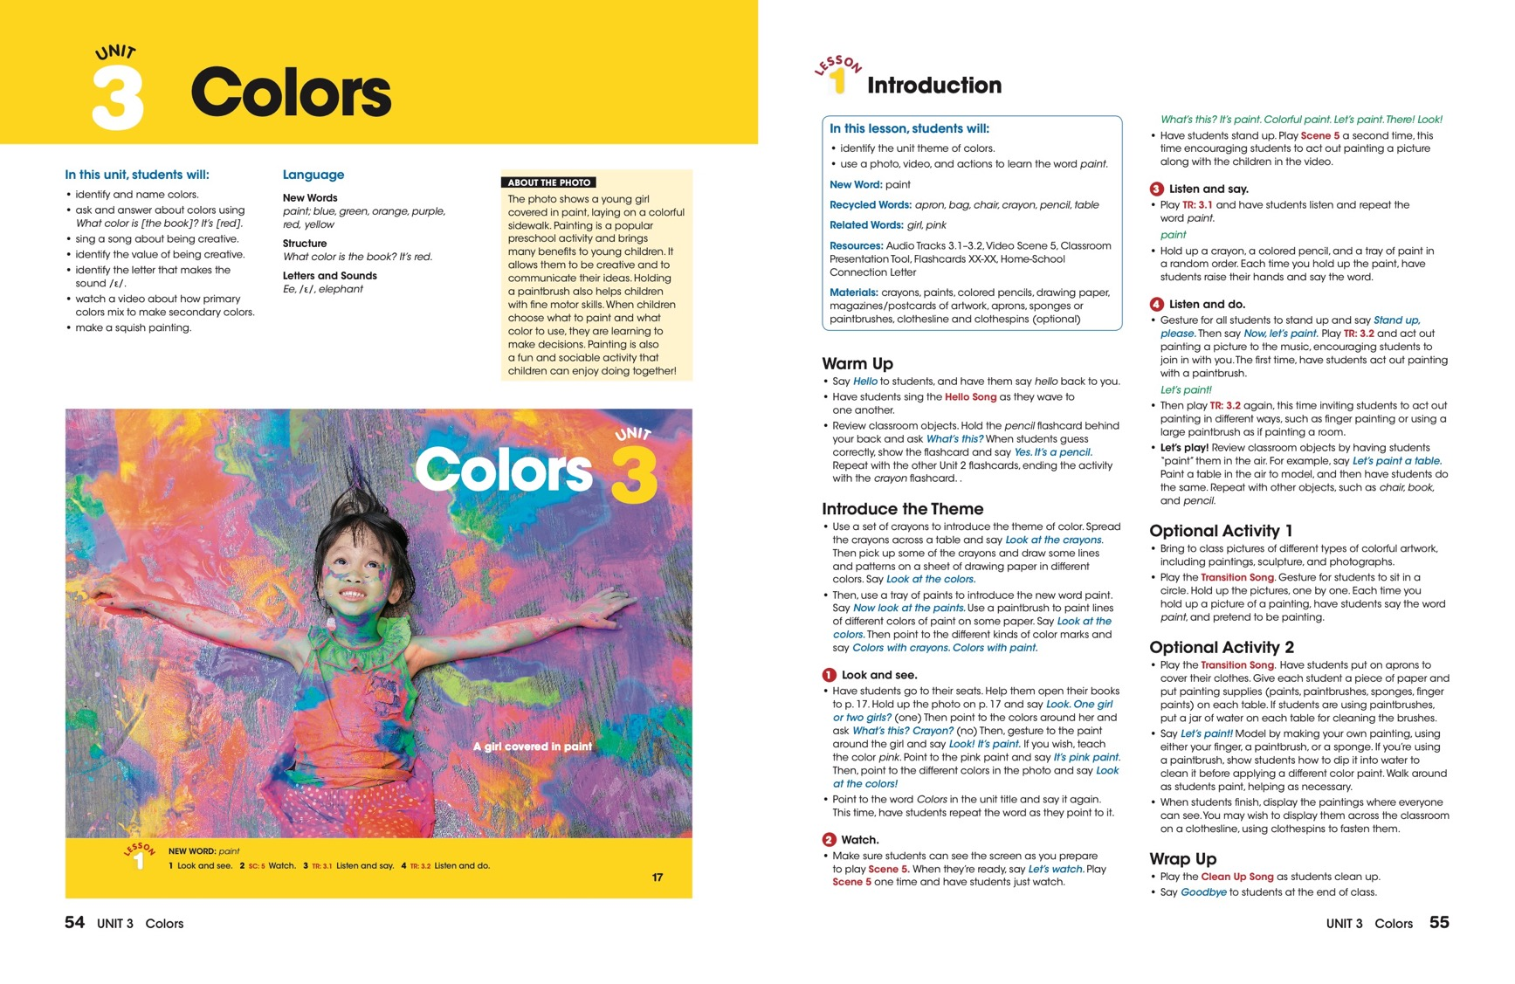
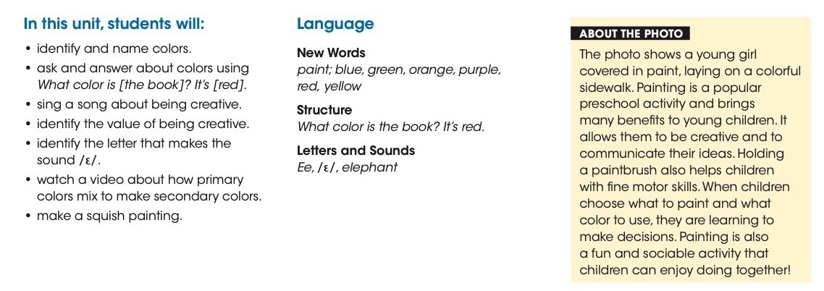
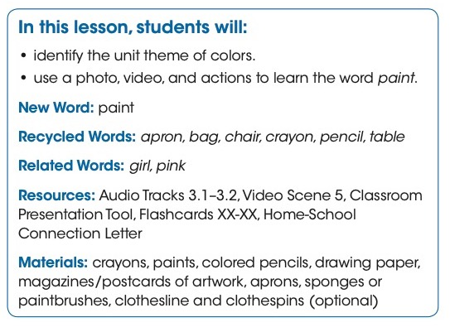
Notes:
What’s in the Teacher’s Book with ABC Poster?
The interleaved Teacher’s Books help instructors teach the Look and See lessons, with step-by-step instructions for every lesson and activity in the Student’s Books and Activity Books.
In addition, teachers are provided:
List of 21st Century Skills covered in every unit
List of language covered in every unit
Expected outcomes of every lesson ­and a list of the resources available to teach the lesson
About the Video and About the Photo information
Language Strategies, Teacher Tips, and Rhyming Words boxes
End-of-unit Across the Curriculum boxes, with explanations of the CLIL topic of each unit and suggestions for exploring the topic across other subject areas.
An ABC Poster is also included for classroom use, with full alphabet and vowels presentation using photos from the National Geographic Photo Ark.
Access to the Teacher’s Companion Site is provided on the Inside Front Cover of the Teacher’s Book.

Slide 15
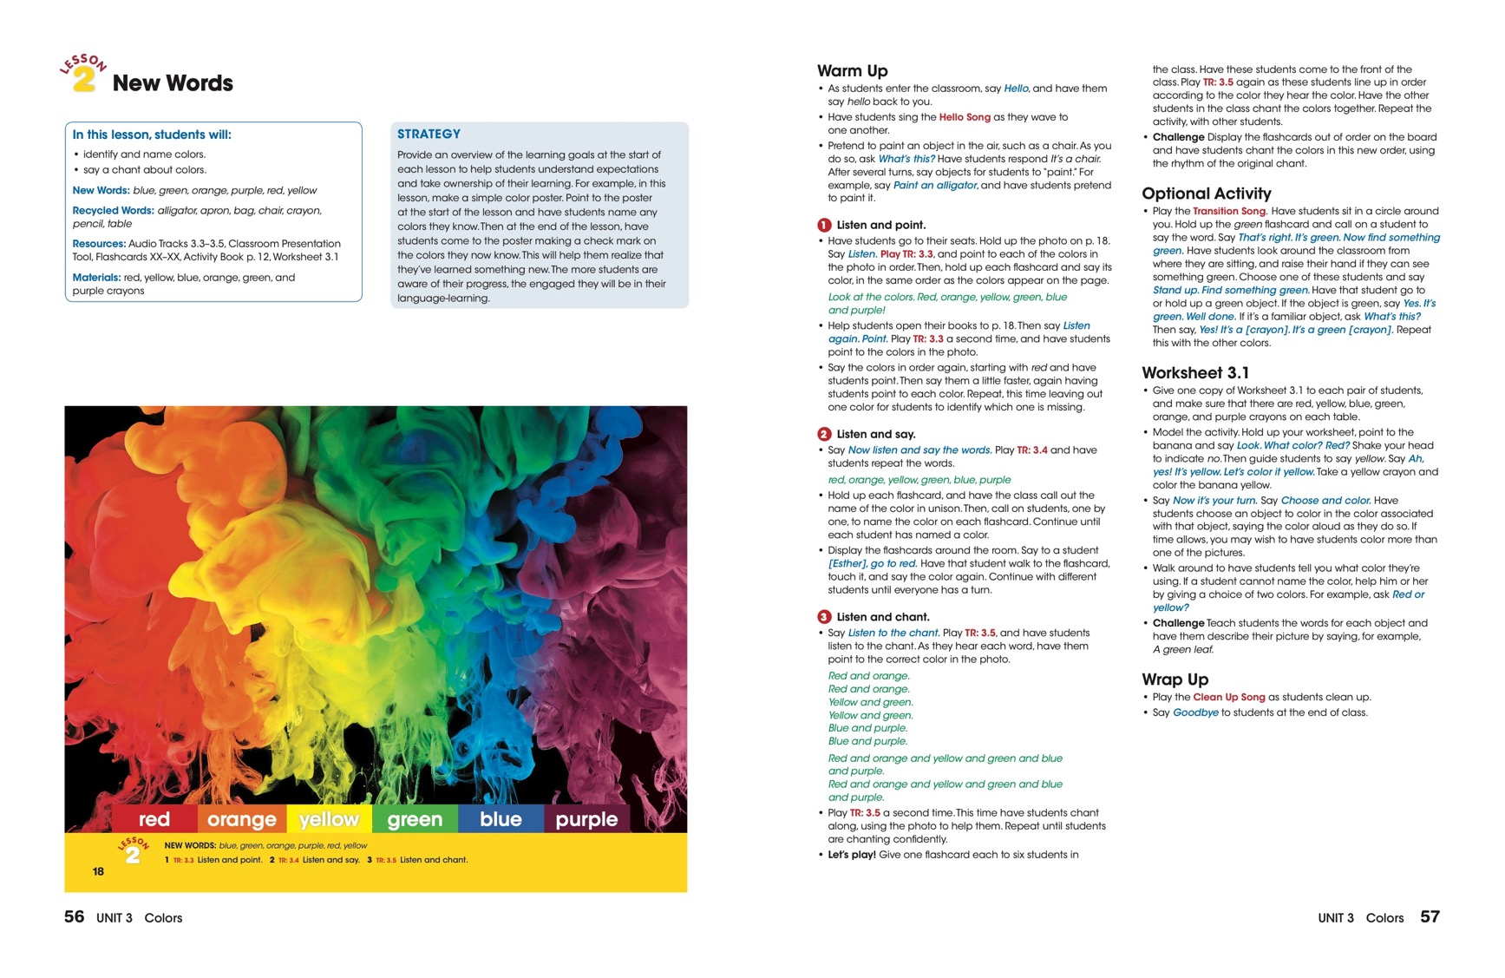
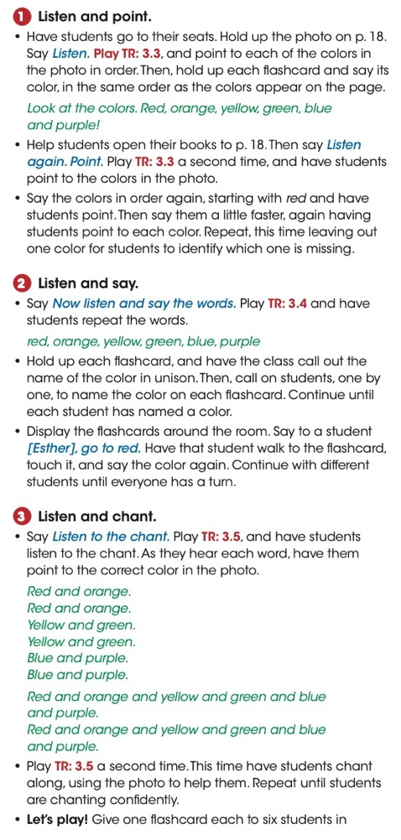
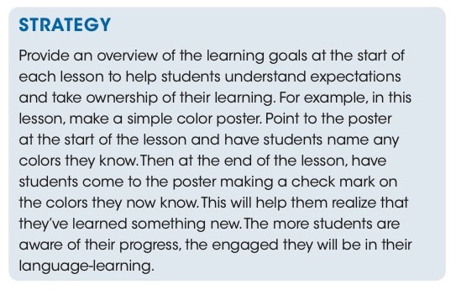

Slide 16
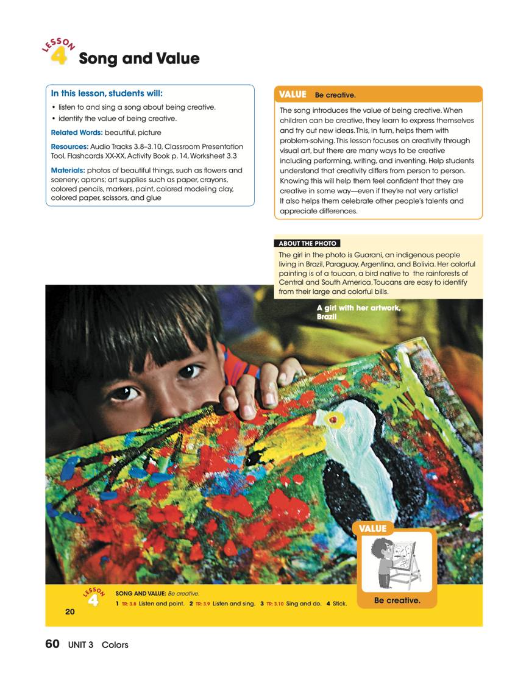
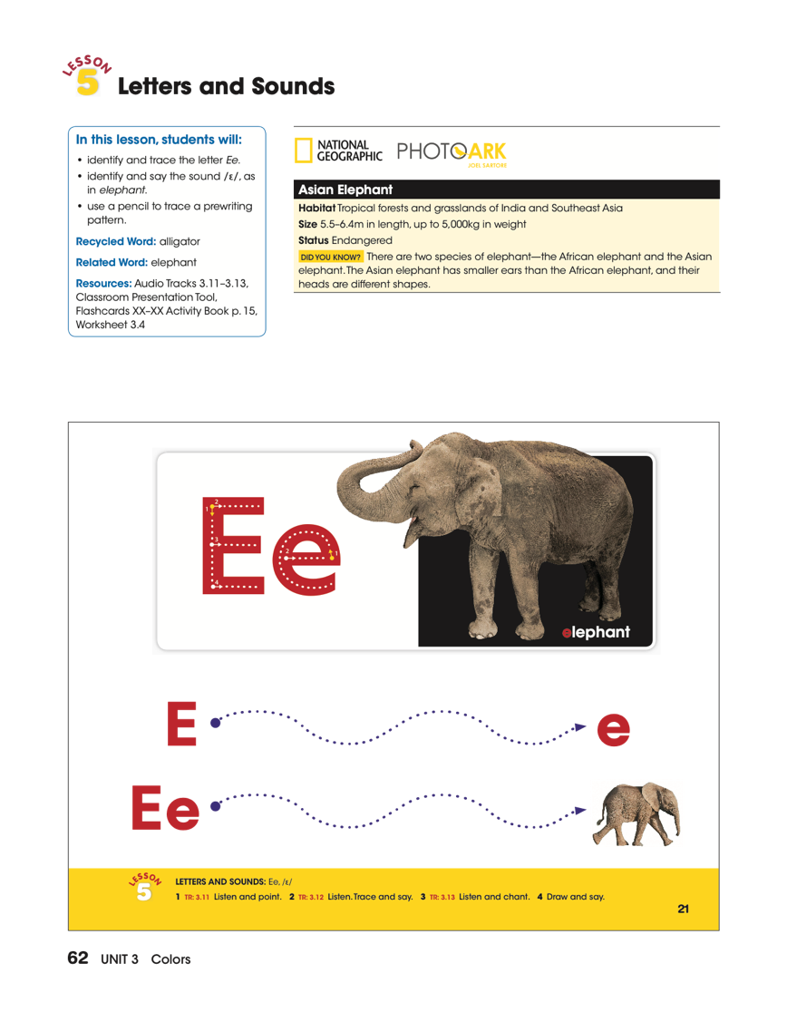
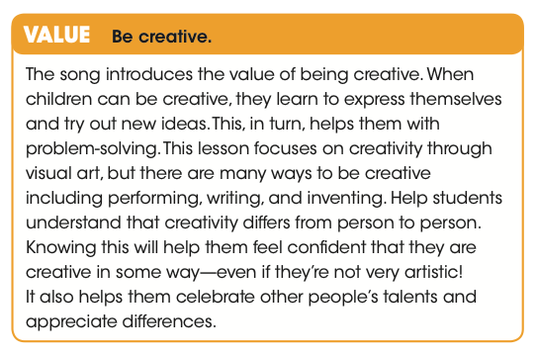
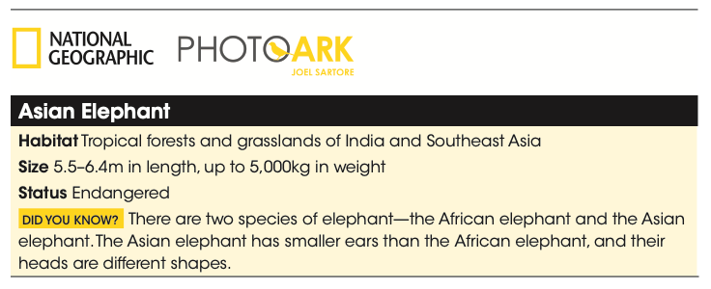

Slide 17
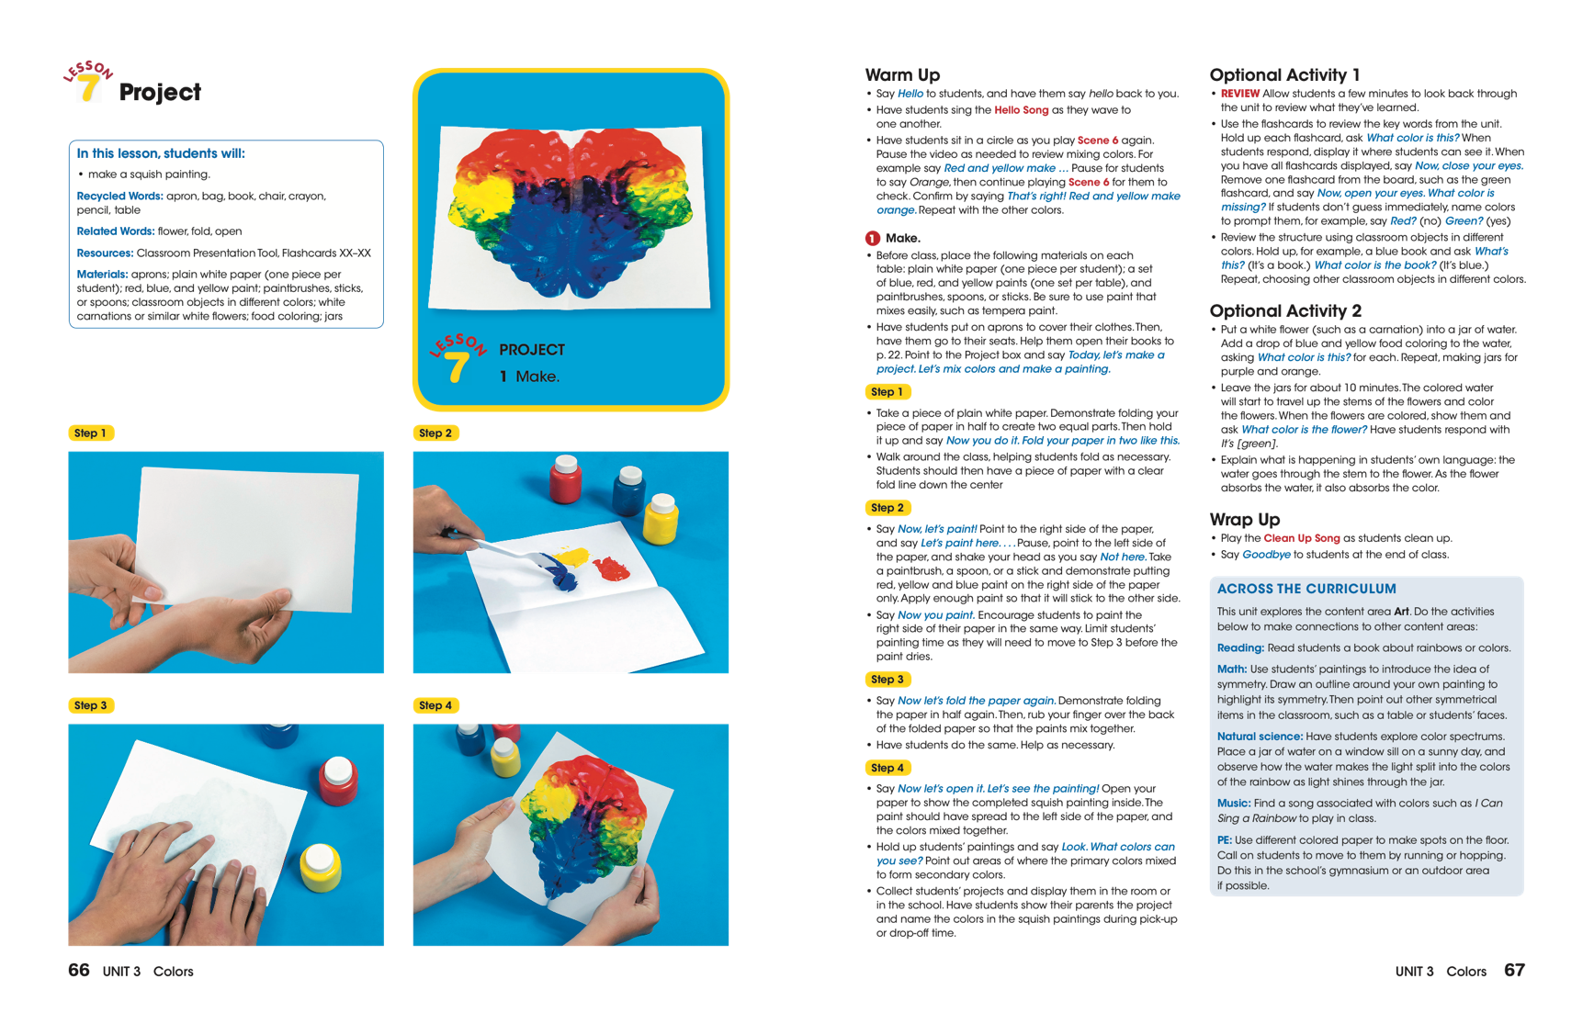
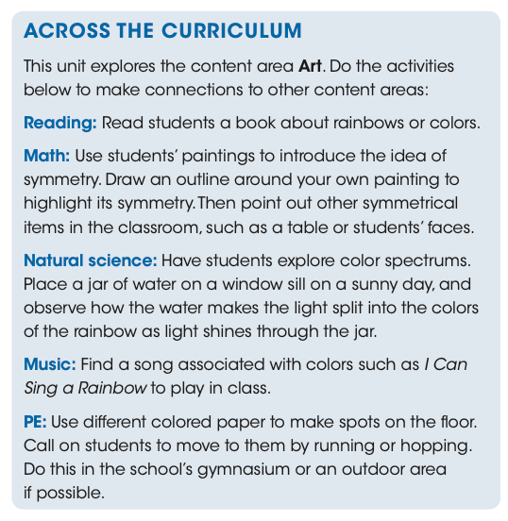
Notes:
ACROSS THE CURRICULUM
Across The Curriculum boxes at the end of every Teacher’s Book unit explicitly state the content area explored in the unit and offer additional activities to make connections to other content areas.

Slide 18
Notes:
What’s in the Activity Books?
The Look and See Activity Books contain activities that reinforce and consolidate Student’s Book instruction. Each unit provides practice with the Student’s Book vocabulary, structures, songs, values, phonics, and video.
The Activity Book features:
Four pages of skills practice and activities
Review sections
English pronunciation practice
Audio for all listening activities, available online at the Companion Site

Slide 19
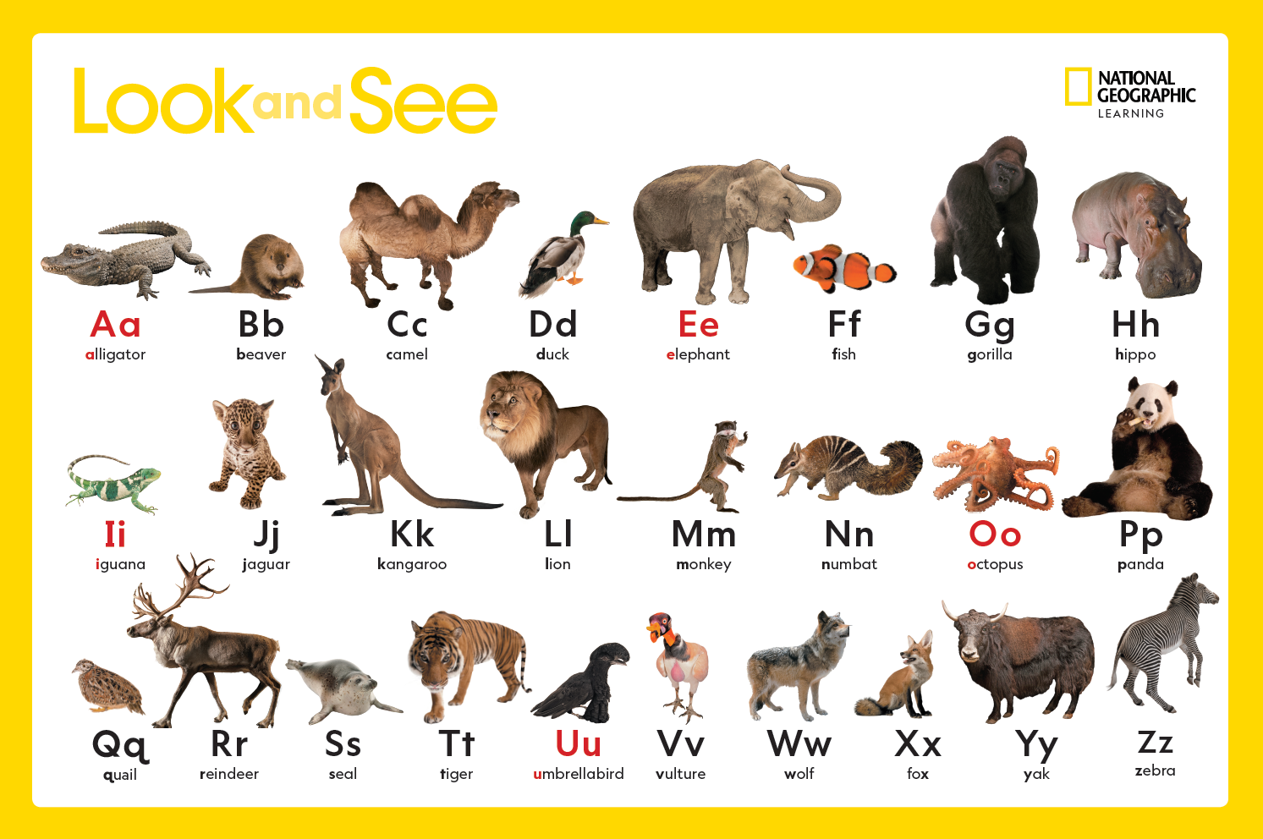
ABC Poster
Notes:
An ABC Poster is included with every Teacher’s Book, featuring animals from the National Geographic Photo Ark.

Slide 20
Formative Assessment Framework
Notes:
How is assessment handled in Look and See?
Tests:
A test for every unit is available on the Teacher’s Companion Site, for age-appropriate formal assessment.
Informal Assessment:
Look and See explains and provides informal assessment opportunities as an important part of classroom routine in the Assessing Young Learners section in the front of the Teacher’s Book. Informal assessment helps students see how much they have learned, which boosts confidence. It also helps them realize when they haven’t quite grasped the information. As students become aware of what they can do to improve, they become more active learners.
Formative Assessment Framework:
A Formative Assessment Framework is included in the Teacher’s Book. Formative assessment means using regular—often informal—assessment to check students’ progress, and then using the result of that assessment to help plan remedial lessons and activities. The Framework lists some performance descriptors for listening and speaking activities, based on the Common European Framework of Reference (CEFR). It suggests some informal assessment activities for each performance descriptor, together with suggestions for remedial activities and a follow-up assessment activity.

Slide 21
Notes:
Classroom Presentation Tool
Enrich your lessons with interactive Student’s Book and Activity Book pages with embedded audio, video, and games and activities on the Classroom Presentation Tool.
The Classroom Presentation Tool is available on USB or streaming online (online access can be made available by Tier 1 support request).

Slide 22
Notes:
What are the Big Book Anthologies?
Every level of Look and See includes a Big Book Anthology to introduce students to the joys of reading.
Each Anthology includes 5 stories which recycle the language and themes covered in the Student’s Books.
Teacher’s Notes provide support to help use each story in the classroom.
Audio for each story is available on the Teacher Resource Website section.

Slide 23
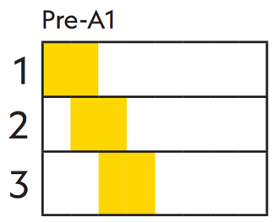
For Learners
Student’s Book
Activity Book
Online Student Resources
For Teachers
Teacher’s Book with ABC Poster
Classroom Presentation Tool
Flashcards
Big Book Anthology
Online Teacher Resources
AVAILABLE IN AMERICAN
AND BRITISH ENGLISH
Up to 180 hours/level
Up to 6 hours/week
Notes:
What’s included with the Flashcards?
The Flashcards for every Level are single-sided, and include pictures corresponding to:
Level 1: the vocabulary covered in the New Words lessons and the letters and numbers covered in the Letters/Numbers lessons.
Level 2: the vocabulary covered in the New Words lessons and the letters and numbers covered in the Letters/Numbers lessons
Level 3: the vocabulary covered in the New Words lessons and sounds covered in the Phonics lessons.
The opposite side of the cards are blank and dry-erasable, allowing teachers to write on them if they choose to, or play any of the activities and games provided in the included Flashcards guide.
The number of cards is as follows:
Level 1: 86
Level 2: 109
Level 3: 138
What is available on the Student’s Companion Site?
Parents have access to resources on the Student’s Companion site at ELTNGL.com/lookandsee, including:
Student’s Book audio
Activity Book audio
Parents will find a URL to their level content on the Inside Front Cover of their Student’s Books and Activity Books.
What is on the Teacher’s Companion Site?
Access to the Teacher’s Companion Site is provided on the Inside Front Cover of the Teacher’s Book.
Student’s Book, Activity Book, and Big Book Anthology audio
Unit-by-unit Pacing Guides for easy lesson planning
Printable Worksheets for extension activities
Audio scripts
Home-School Connection Letters
Assessment Tests

